Slide 1
Jenkins for GeantV and VecGeom
Service portal at CERN:
https://cern.service-now.com/service-portal/service-element.do?name=CI-Jenkins&s=jenkins
Documentation
http://jenkinsdocs.web.cern.ch/jenkinsdocs
Documentation and Use of preconfigured Jenkins jobs

Slide 2
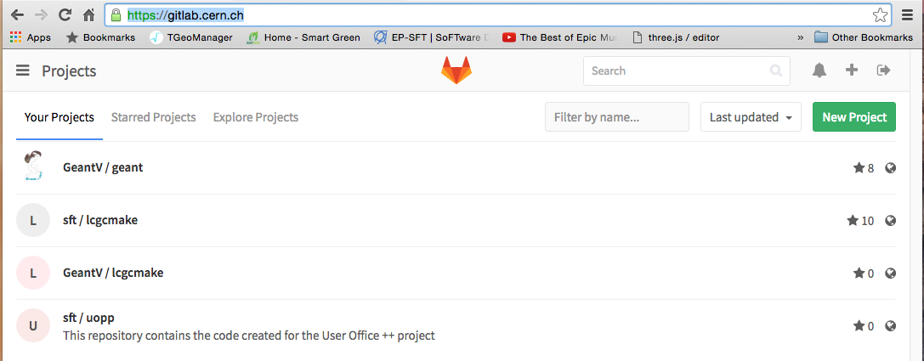
Gitlab
https://gitlab.cern.ch/
Check the site
Note: There is a plugin which enables http communication between gitlab and Jenkins. For example, Jenkins capture some information like
${gitlabSourceBranch} & ${gitlabTargetBranch} which is then used inside the jobs configuration.
Gitlab contain source code of projects and jenkins scripts
https://wiki.jenkins-ci.org/display/JENKINS/GitLab+Plugin

Slide 3
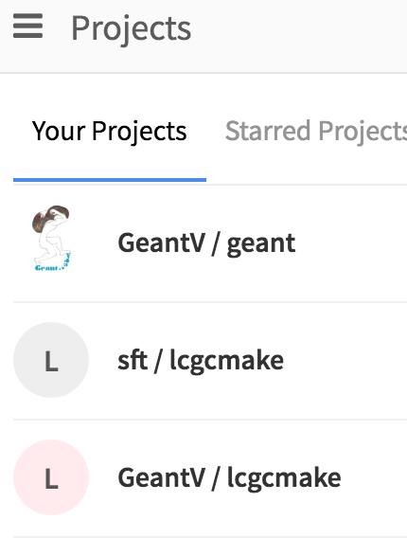
Jenkins & Gitlab
https://gitlab.cern.ch
Jenkins will download the source code of the software from Gitlab (GeantV/geant) to a local directory in order to configure make-files and compile the code.
The location is specified
in the configuration of
the job/project.
During the configuration (cmake) phase, Jenkins will execute the scripts located in the sub-directory “Jenkins”.
It is not automatic but the user define the instruction during the definition of the Jenkins job
…
Jk-all.sh

Slide 4
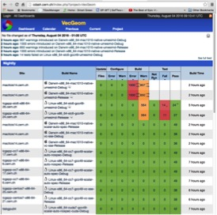
CDASH
http://cdash.cern.ch/
Check the site
CDASH displays the status of the jobs compiled and tested by jenkins

Slide 5
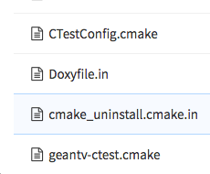
Jenkins & CDASH (1/2)
https://gitlab.cern.ch
CDASH gets configured and receives the information by executing two scripts located in Jenkins subdirectory of the project (GeantV) in Gitlab.
…
Jk-all.sh

Slide 6
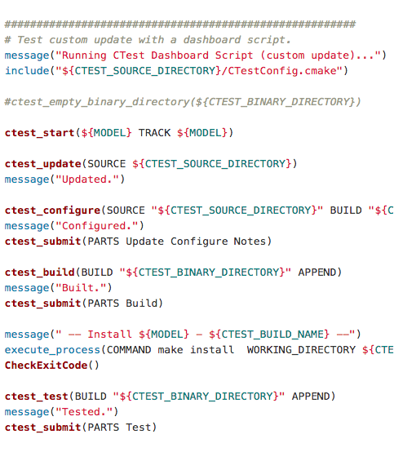
Jenkins & CDASH (2/2)
CDASH gets configured and receives the information by executing two scripts located in Jenkins subdirectory of the project (GeantV) in Gitlab.
…
The script CTestConfig.cmake defines what kind of information is to be sent.
The script
geantv-ctest.cmake sends the information to CDASH.
…

Slide 7
Jenkins jobs (Projects)
Keep In Mind
Each project is configured to contains a number of variables/parameters and their values are given in the configuration interface or they are specified each time when the project is executed (input parameters).
Those parameters are also defined like environment variables on each node where the scripts will be physically executed.
GeantV and VecGeom preconfigured Jenkins jobs

Slide 8
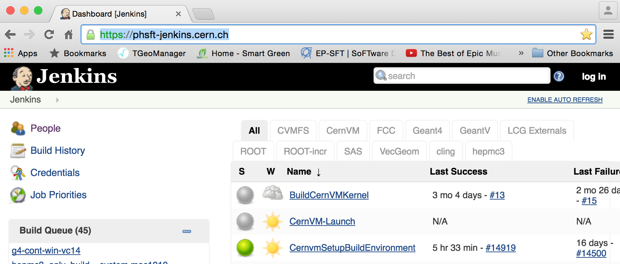
https://phsft-jenkins.cern.ch/

Slide 9
GEANTV
coverity_geantv
GeantV-CUDA-gitlab
GeantV-Doxygen
GeantV-eclair-testing
GeantV-gitlab
GeantV-TGeo-gitlab
GeantV-VecGeom-gitlab
MemoryChecker
nightly-GeantV
nightly-GeantV-cuda-NOspecOFF-scalar
nightly-GeantV-CUDA-NOspecOFF-vc
nightly-GeantV-cuda-NOspecON-scalar
nightly-GeantV-cuda-NOspecON-vc
nightly-GeantV-NOspecOFF-scalar
nightly-GeantV-NoSpecOFF-vc
nightly-GeantV-NOSpecON-scalar
nightly-GeantV-NOspecON-Vc
nightly-GeantV-TGeo
VecGeom
Check-VecGeom-AVX
Check-VecGeom-scalar-nospec
Check-VecGeom-scalar-spec
coverity_vecgeom
nightly-VecGeom
nightly-VecGeom-cudaOFF-NOspecOFF-vc
nightly-VecGeom-cudaOFF-NOspecON-vc
nightly-VecGeom-cudaON-NOspecOFF-scalar
nightly-VecGeom-cudaON-NOspecOFF-vc
nightly-VecGeom-cudaON-NOspecON-scalar
nightly-VecGeom-cudaON-NOspecON-vc
nightly-VecGeom-MIC
Nightly-VecGeom-Umesimd
VecGeom-Doxygen
Vecgeom-eclair-testing
VecGeom-gitlab
VecGeom-gitlab-CUDA
VecGeom-gitlab-scalar
VecGeom-gitlab-sse3
VecGeom-MemChecker
lcg_externals
genser-quickval
lcg-clean-builds
lcg-clean-lcgsoftDB
lcg-clean-rpmsarea
lcg-prepare-builds
lcg_cleanNightliesFromAFS
lcg_experimental
lcg_ext_dev2
lcg_ext_dev2_atlas
lcg_ext_dev2_pmendez
lcg_ext_dev3
lcg_ext_dev4
lcg_ext_dev4_emailtesting
lcg_geant4externals_install
lcg_geantvexternals_install
lcg_release
lcg_release_api
lcg_release_dbg
lcg_release_generators
lcg_release_installToAFS
lcg_release_installToAll
lcg_release_installToAll_dbg_api
lcg_rootext_install

Slide 10
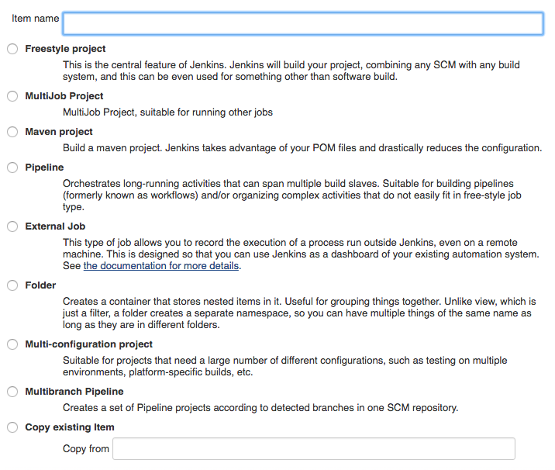
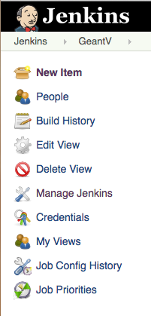
Types of Jenkins Jobs

Slide 11
External packages
Externals for Geantv and VecGeom:
ROOT, Geant4 , hepmc3, Vc, pythia8 and umesimd

Slide 12
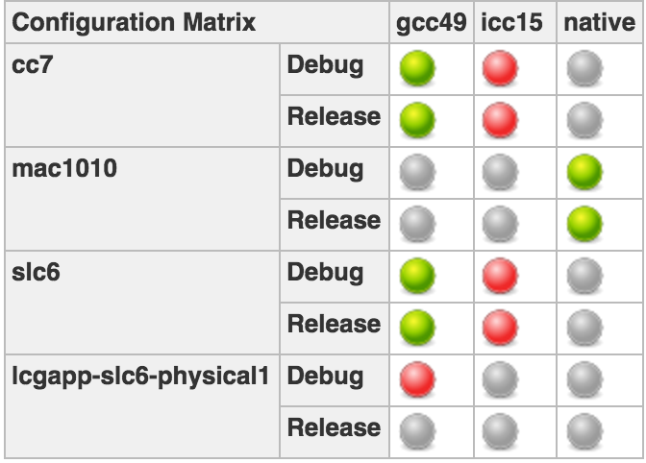
lcg_geantvexternals_install
Jenkins job parameters
As for July-2016 we use the latest version of ROOT with the specific patch for GeantV
Parameter | Value
LCG_VERSION | geantv
SLOT | externals-testjuin2016
Combinations
VERSION_MAIN | v6-06-00-patches
TARGET | ROOT Geant4 hepmc3 Vc pythia8 umesimd
TEST_LABELS | None
INSTALLDIR | /afs/cern.ch/sw/lcg/app/releases/GEANTV-externals/$SLOT
LCG_INSTALL_PREFIX | /afs/cern.ch/sw/lcg/app/releases/GEANTV-externals/$SLOT
VERSION_JENKINS | master
LCG_EXTRA_OPTIONS | -DLCG_SOURCE_INSTALL=OFF
Comments:
This job will build all externals used by GeantV and VecGeom and will store them in AFS “/afs/cern.ch/sw/lcg/app/releases/GEANTV-externals/$SLOT”. Those externals are: “ROOT, Geant4 , hepmc3, Vc, pythia8, umesimd” as defined in the “TARGET” parameter above.
It should be taken into consideration that “ROOT, Geant4 , hepmc3, Vc, pythia8, umesimd” also use other externals and they will also be compiled and stored in in AFS “/afs/cern.ch/sw/lcg/app/releases/GEANTV-externals/$SLOT”:

Slide 13
lcg_geantvexternals_install
Description:
GeantV and VecGeom externals installation in AFS
Jenkins job Configuration
✔ Execute concurrent builds if necessary
Type | Name | Value | Description
String | LCG_VERSION | geantv | LCG version (71, dev4, ...)
String | SLOT | externals-testjuin2016 | Nightly slot name
Matrix Comb | Combinations
String | VERSION_MAIN | v6-06-00-patches | LCGCMake branch to use for the build (master, experimental…
String | TARGET | ROOT Geant4 hepmc3 Vc pythia8 umesimd | LCGCMake target (name of the top level package)
String | TEST_LABELS | None | Test label regular expression selection (e.g. Release|Nightly)
String | INSTALLDIR | /afs/cern.ch/sw/lcg/app/releases/GEANTV-externals/$SLOT | Area where already existing packages are
String | LCG_INSTALL_PREFIX | Same as INSTALLDIR | Area where to install new packages
String | VERSION_JENKINS | master
String | LCG_EXTRA_OPTIONS | -DLCG_SOURCE_INSTALL=OFF
Slaves - LABEL
Labels | cc7, mac1010, slc6
Individual nodes | lcgapp-slc6-physical1
User Defined Axis
COMPILER | gcc49 icc15 native
BUILDTYPE | Debug Release
Parameters
BUILD ENVIRONMENT
Delete workspace before build starts
Tie parent build to a node: master
Source Code Management -> ( Multiple SCMs)
Git | Repository URL | https://gitlab.cern.ch/sft/lcgjenkins.git
 | Branches to build | */${VERSION_JENKINS}
 | Local subdirectory for repo | lcgjenkins
Git | Repository URL | https://gitlab.cern.ch/sft/lcgcmake.git
 | Branches to build | */${VERSION_MAIN}
 | Local subdirectory for repo | lcgcmake
Post-build Actions: Editable Email Notification
Project Recipient List | ilias.goulas@cern.ch, gunter.folger@cern.ch
Project Reply-To List | $DEFAULT_REPLYTO
Content Type | Default Content Type
Default Subject | $DEFAULT_SUBJECT
Default Content | The job number $BUILD_NUMBER of the project $PROJECT_NAME …
Attach Build Log | Do Not Attach Build Log
Trigger for matrix projects | Trigger only the parent job
Type;
Multiconfiguration
Execute Shell
source lcgjenkins/jk-setup.sh $BUILDTYPE $COMPILER $SLOT
lcgjenkins/jk-runbuild.sh
rm -rf $WORKDIR/$PLATFORM-build
rm -rf $WORKDIR/$PLATFORM-install

Slide 14
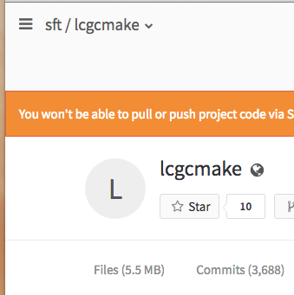
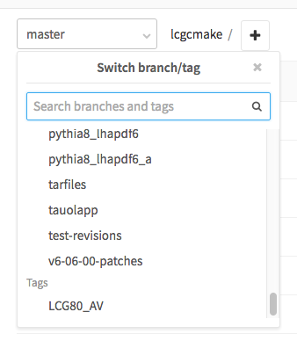
LCG branch for Externals
https://gitlab.cern.ch
Change Branch
This branch was created in order to compile all external with specific parameters used by GeantV and VecGeom
It is defined by the variable “VERSION_MAIN” in the “lcg_geantvexternals_install” jenkins project
VERSION_MAIN | v6-06-00-patches

Slide 15
Important files for externals (you need to know!!!)
In Gitlab, once it has been chosen the project “sft / lcgcmake”, “Files” and the branch “v6-06-00-patches“:
In the subdirectory documentation, you can find guidelines on performing main tasks like creation of AFS space management, Toolchain information etc
https://gitlab.cern.ch/sft/lcgcmake/tree/v6-06-00-patches/documentation
All depended packages and their version are listed in the file “heptools-geantv.cmake” using a specific format. You may need to modify the list of packages or add a new one in order to compile externals when requested.
https://gitlab.cern.ch/sft/lcgcmake/blob/v6-06-00-patches/cmake/toolchain/heptools-geantv.cmake

Slide 16
GEantv
GEANTV
coverity_geantv
GeantV-CUDA-gitlab
GeantV-Doxygen
GeantV-eclair-testing
GeantV-gitlab
GeantV-TGeo-gitlab
GeantV-VecGeom-gitlab
MemoryChecker
nightly-GeantV
nightly-GeantV-cuda-NOspecOFF-scalar
nightly-GeantV-CUDA-NOspecOFF-vc
nightly-GeantV-cuda-NOspecON-scalar
nightly-GeantV-cuda-NOspecON-vc
nightly-GeantV-NOspecOFF-scalar
nightly-GeantV-NoSpecOFF-vc
nightly-GeantV-NOSpecON-scalar
nightly-GeantV-NOspecON-Vc
nightly-GeantV-TGeo
Jenkins Projects by type and periodicity

Slide 17
GeantV Jenkins Projects by type
GEANTV jenkins project name | Project type | Comment
coverity_geantv | Multi-configuration | Triggered by job coverity_vecgeom
GeantV-CUDA-gitlab | Multi-configuration | Triggered by multijob
GeantV-Doxygen | Multi-configuration | Documentation (triggered by vecgeom doxygen)
GeantV-eclair-testing | Multi-configuration | Checker coding convention (triggered by vecgeom doxy..)
GeantV-gitlab | Multijob | Triggered by Merge request
GeantV-TGeo-gitlab | Multi-configuration | Triggered by multijob
GeantV-VecGeom-gitlab | Multi-configuration | Triggered by multijob
MemoryChecker | Multi-configuration | On weekends (periodic)
nightly-GeantV | Multi-configuration | Triggered by nightly vecgeom
nightly-GeantV-cuda-NOspecOFF-scalar | Multi-configuration | Triggered by the same job in vecgeom
nightly-GeantV-CUDA-NOspecOFF-vc | Multi-configuration | Triggered by the same job in vecgeom
nightly-GeantV-cuda-NOspecON-scalar | Multi-configuration | Triggered by the same job in vecgeom
nightly-GeantV-cuda-NOspecON-vc | Multi-configuration | Triggered by the same job in vecgeom
nightly-GeantV-NOspecOFF-scalar | Multi-configuration | Triggered by the same job in vecgeom
nightly-GeantV-NoSpecOFF-vc | Multi-configuration | Triggered by the same job in vecgeom
nightly-GeantV-NOSpecON-scalar | Multi-configuration | Triggered by the same job in vecgeom
nightly-GeantV-NOspecON-Vc | Multi-configuration | Triggered by the same job in vecgeom
nightly-GeantV-TGeo | Multi-configuration | Triggered by the same job in vecgeom

Slide 18
Multi-configuration job
Example of Jenkins job configuration

Slide 19
coverity_geantv
Multi-configuration project coverity_geantv
Parameter | Value | Comments
EXTERNALS | externals-testjuin2016 | afs directory keeping the external libraries
ExtraCMakeOptions | -DUSE_VECGEOM_NAVIGATOR=ON
Combinations
BACKEND | VecGeom-Coverity
BUILDTYPE | Release
VERSION | master | branch to clone
TYPE | vc-sse
Comments:
Configurations: default
Upstream Projects: coverity_vecgeom

Slide 20
coverity_geantv
Description:
Nightly Coverity check of GeantV prototype:
to see current results just push "default button" -> last build available on "Coverity Defects Plot”
or go to https://coverity.cern.ch -> Project GeantV-> Issues: Project Scope
Jenkins job Configuration
✔ Execute concurrent builds if necessary
Type | Name | Value | Description
String | EXTERNALS | externals-testjuin2016 | afs directory keeping the external libraries
String | ExtraCMakeOptions | -DUSE_VECGEOM_NAVIGATOR=ON | Additional CMake configuration options of the form "-Doption1=value1 -Doption2=value2"
Matrix Comb | Combinations
String | BACKEND | VecGeom-Coverity
String | BUILDTYPE | Release
String | VERSION | master | Branch to clone
String | TYPE | Vc-sse
Node
Default | buildcoverity
Possiblenodes | buildcoverity
User Defined Axis
COMPILER | COMPILER
BUILDTYPE | Debug Release
Slaves - LABEL
Labels | slc6
Individual nodes
This parameter indicates the name of VecGeom subdirectory in AFS where VecGeom files for this type are located
Parameters
Prepare an environment for the run
Keep Jenkins Environment Variables
Keep Jenkins Build Variables
Properties Content: MODE=continuous
BUILD ENVIRONMENT
Delete workspace before build starts
Tie parent build to a node: master
Source Code Management -> ( Multiple SCMs)
Git | Repository URL | https://gitlab.cern.ch/GeantV/geant.git
 | Branches to build | */${VERSION}
 | Local subdirectory for repo | geant
Post-build Actions
TRIGER
Build after other projects are built
Project to watch: coverity_vecgeom
Type;
Multiconfiguration
Console Output (build log) parsing
Mark build Unstable on Warning
Mark build Failed on Error
Default log parser rules
This job is triggered when Coverity_vecgeom os finished
Execute Shell
cd geant
ARCH=$(uname –m)
if [[ $BUILDTYPE == "Debug" ]] then CORRECTEDBUILDTYPE="dbg” else CORRECTEDBUILDTYPE="opt” fi
export PYTHIA8_DIR=/afs/cern.ch/sw/lcg/app/releases/GEANTV-externals/${EXTERNALS}/MCGenerators/pythia8/186/${ARCH}-${LABEL}-${COMPILER}-${CORRECTEDBUILDTYPE}
mkdir -p installation
mkdir -p builds && cd builds../jenkins/jk-all
touch $WORKSPACE/controlfile
Coverity (Check configuration, Streams)
Coverity Connect instance: lcgapp10
Project: GeantV
Language: CXX
Perform Coverity build, analysis and commit

Slide 21
Multijob
Example of Jenkins multijob configuration

Slide 22
GeantV-gitlab
MultiJob Project GeantV-gitlab
Parameter | Value | Comments
EXTERNALS | externals-testjuin2016 | afs directory keeping the external libraries
ExtraCMakeOptions | -DCUDA=ON -DUSE_VECGEOM_NAVIGATOR=ON
Combinations
BACKEND | ${COMPILER}-CUDA-VecGeom-${gitlabSourceBranch}-master-${TYPE}
VERSION | master | branch to clone
TYPE | vc-auto-nospec-cuda
Comments:
Upstream Projects:
Downtream Projects:
GeantV-CUDA-gitlab
GeantV-TGeo-gitlab
GeantV-VecGeom-gitlab

Slide 23
GeantV-gitlab
Jenkins job Configuration
MultiJob
Source Code Management
Git | Repository URL | https://gitlab.cern.ch/GeantV/geant.git
 | Branch Specifier | origin/${gitlabSourceBranch}
Prepare an environment for the run
Keep Jenkins Environment Variables
Keep Jenkins Build Variables
Properties Content: MODE=nightly
Branches to build
Git | Branch Specifier | origin/${gitlabSourceBranch}
Repository browser: gitlab
Git | URL | https://gitlab.cern.ch/VecGeom/VecGeom.git
 | version | 8.5
Type;
Multijob
Multijob Phase
Phase Name:
Merge before build
Git | Name of repository | origin
 | Branch to merge | ${gitlabTargetBranch}
 | Merge strategy Fast-forward mode | Default -ff
Job Name:
GeantV-TGeo-gitlab
GeantV TGEO Navigator Build
Continuation condition to next phase when jobs' statuses are: Complete
Job Name:
GeantV-VecGeom-gitlab
GeantV VecGeom Navigator Build
Continuation condition to next phase when jobs' statuses are: Complete
TRIGER
Build when a change is pushed to GitLab. GitLab CI Service URL: https://phsft-jenkins.cern.ch/project/GeantV-CUDA-gitlab
Build on Merge Request Events
Allow all branches to trigger this job
Job Name:
GeantV-CUDA-gitlab
GeantV VecGeom Scalar (nospec) CUDA Build
Continuation condition to next phase when jobs' statuses are: Complete

Slide 24
GeantV-CUDA-gitlab
Multi-configuration project GeantV-CUDA-gitlab
Parameter | Value | Comments
EXTERNALS | externals-testjuin2016 | afs directory keeping the external libraries
ExtraCMakeOptions | -DCUDA=ON -DUSE_VECGEOM_NAVIGATOR=ON
Combinations
BACKEND | ${COMPILER}-CUDA-VecGeom-${gitlabSourceBranch}-master-${TYPE}
VERSION | master | branch to clone
TYPE | vc-auto-nospec-cuda
Comments:
Upstream Projects: GeantV-gitlab

Slide 25
GeantV-CUDA-gitlab
Description:
Jenkins job Configuration
✔ Execute concurrent builds if necessary
User Defined Axis
Name | BUILDTYPE
Values | Debug Release
Type | Name | Value | Description
String | EXTERNALS | externals-testjuin2016 | afs directory keeping the external libraries
String | ExtraCMakeOptions | -DCUDA=ON -DUSE_VECGEOM_NAVIGATOR=ON | Additional CMake configuration options of the form "-Doption1=value1 -Doption2=value2"
Matrix Comb | Combinations
String | BACKEND | ${COMPILER}-CUDA-VecGeom-${gitlabSourceBranch}-master-${TYPE}
String | VERSION | master | Branch to clone
String | TYPE | vc-auto-nospec-cuda
User Defined Axis
Name | COMPILER
Values | gc49
Slaves - LABEL
Labels | Continous-cuda7
Individual nodes
Source Code Management -> ( Multiple SCMs)
Git | Repository URL | https://gitlab.cern.ch/GeantV/geant.git
 | Branches to build | origin/${gitlabSourceBranch}
 | Gitlab version | 8.5, dir:geant
Parameters
Prepare an environment for the run
Keep Jenkins Environment Variables
Keep Jenkins Build Variables
Properties Content: MODE=contimous
BUILD ENVIRONMENT
Delete workspace before build starts
Tie parent build to a node: master
Merge before build, repository: origin, Branch: ${gitlabTargetBranch} (-ff )
TRIGER
Build when a change is pushed to GitLab. GitLab CI Service URL: https://phsft-jenkins.cern.ch/project/GeantV-CUDA-gitlab
Build on Merge Request Events
Allow all branches to trigger this job
Post-build Actions
Type;
Scan for compiler warnings: GNU C Compiler 4 (gcc)
Multiconfiguration
Execute Shell
Console Output (build log) parsing
Mark build Failed on Error
VecGeom/GentV log parser rules
#!/bin/bash
cd geant
git checkout ${VERSION}
ARCH=$(uname -m)
if [[ $BUILDTYPE == "Debug" ]] then CORRECTEDBUILDTYPE="dbg” else CORRECTEDBUILDTYPE="opt” fi
export PYTHIA8_ROOT_DIR=/afs/cern.ch/sw/lcg/app/releases/GEANTV-externals/${EXTERNALS}/MCGenerators/pythia8/186/${ARCH}-${LABEL}-${COMPILER}-${CORRECTEDBUILDTYPE}
mkdir -p builds && cd builds
touch $WORKSPACE/controlfile; rm -rf ../geant; rm -rf builds
Ctest-Version N/A (default)
patern: geant/builds/Testing/**/Test.xml
Skip if there are no test files
Delete temporary Junit files
Email notification: geant-build@cern.ch

Slide 26
Nightly jobs
GeantV jenkins Jobs that run every night

Slide 27
nightly-GeantV
Multi-configuration project nightly-GeantV
Parameter | Value | Comments
EXTERNALS | externals-testjuin2016 | afs directory keeping the external libraries
ExtraCMakeOptions | -DUSE_VECGEOM_NAVIGATOR=ON
Combinations
BACKEND | ${COMPILER}-VecGeom-${TYPE}
VERSION | master | branch to clone
TYPE | vc-sse
Comments:
Upstream Projects: nightly-VecGeom

Slide 28
nightly-GeantV
Description:
Jenkins job Configuration
✔ Discard old builds, Log Rotation, 14c days
✔ Execute concurrent builds if necessary
Type | Name | Value | Description
String | EXTERNALS | externals-testjuin2016 | afs directory keeping the external libraries
String | ExtraCMakeOptions | -DUSE_VECGEOM_NAVIGATOR=ON | Additional CMake configuration options of the form "-Doption1=value1 -Doption2=value2"
Matrix Comb | Combinations
String | BACKEND | ${COMPILER}-VecGeom-${TYPE}
String | BUILDTYPE | Release
String | VERSION | master | Branch to clone
String | TYPE | Vc-sse
Node
Default | buildcoverity
Possible | buildcoverity
User Defined Axis
COMPILER | COMPILER
BUILDTYPE | gcc49
Slaves - LABEL
Labels | cc7, slc6
Individual nodes
This parameter indicates the name of VecGeom subdirectory in AFS where VecGeom files for this type are located
Parameters
Prepare an environment for the run
Keep Jenkins Environment Variables
Keep Jenkins Build Variables
Properties Content: MODE=nightly
BUILD ENVIRONMENT
Delete workspace before build starts
Tie parent build to a node: master
Source Code Management -> ( Multiple SCMs)
Git | Repository URL | https://gitlab.cern.ch/GeantV/geant.git
 | Branches to build | */${VERSION}
 | Local subdirectory for repo | geant
Post-build Actions
TRIGER
Build after other projects are built
Project to watch: nightly-VecGeom
Type;
Multiconfiguration
Console Output (build log) parsing
Mark build Unstable on Warning
Mark build Failed on Error
Default log parser rules
This job is triggered when nightly-VecGeom is finished
Execute Shell
cd geant
ARCH=$(uname –m)
if [[ $BUILDTYPE == "Debug" ]] then CORRECTEDBUILDTYPE="dbg” else CORRECTEDBUILDTYPE="opt” fi
export PYTHIA8_DIR=/afs/cern.ch/sw/lcg/app/releases/GEANTV-externals/${EXTERNALS}/MCGenerators/pythia8/186/${ARCH}-${LABEL}-${COMPILER}-${CORRECTEDBUILDTYPE}
mkdir -p installation
mkdir -p builds && cd builds../jenkins/jk-all
touch $WORKSPACE/controlfile
Coverity (Check configuration, Streams)
Coverity Connect instance: lcgapp10
Project: GeantV
Language: CXX
Perform Coverity build, analysis and commit

Slide 30
Conclusions
There is lot of work done in order to configure the environment of interaction between Jenkins, Gitlab and CDASH. Some documentation is available and also the scripts accessible in gitlab. This document is aiming to help new users in using the existing Jenkins environment for GeantV and VecGeom.
As far as the externals is concerning … it is still an issue to be discussed. The branch that was created by Patricia needs to be updated/rebased and tested regularly in order to make sure that it is always possible to compile a new version.
There should be done a few changes in the naming convention in order to identify the equivalent job in jenkins from any entry in CDASH – (Although most of the work is already done).
In order to identify a problem, it is most often needed to login to the physical node where the job is executed and perform manual operations (username: sftnight, password…). The physical node is indicated in the log file of each job through Jenkins.
There is also a pending request to make available a node for performance tests for VecGeom

