Slide 1
Code modernization: The GeantV project
A. Gheata for the GeantV team

Slide 2
Outline
Introduction
Geometry benchmarks: vectorization and scalability
Particle transport improvement
Sub-node clustering
Task based approach
Locality (NUMA), Machine Learning, HPC workloads
Plans

Slide 3
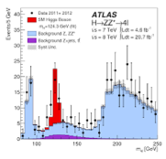
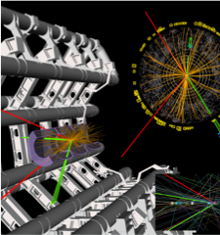
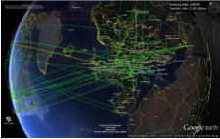

The problem
Detailed simulation of subatomic particles in detectors, essential for data analysis, detector design..
Complex physics and geometry modeling
Heavy computation requirements, massively CPU-bound
200 Computing centers in 20 countries: > 600k cores
@CERN (20% WLCG): 65k processor cores ; 30PB disk + >35PB tape storage
More than 50% of WLCG power for simulations

Slide 4
GeantV – Adapting simulation to modern hardware
GeantV simulation
needs to profit at best from all processing pipelines
Classical simulation
hard to approach the full machine potential
Single event scalar transport
Embarrassing parallelism
Cache coherence – low
Vectorization – low (scalar auto-vectorization)
Multi-event vector transport
Fine grain parallelism
Cache coherence – high
Vectorization – high (explicit multi-particle interfaces)
Notes:
Compared to the classical approach, GeantV transports vectors of tracks grouped by geometry/physics to get access to fine grain parallelism features like ILP/SIMD, with much better cache coherence.

Slide 5
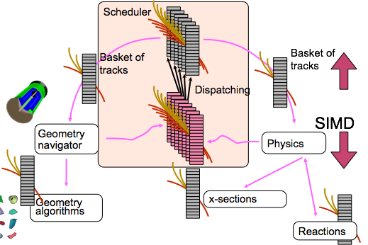


GeantV approach
Transport particles in vectors (“baskets”)
  Filter by geometry volume or physics process
Redesign library and workflow to target fine grain parallelism
Use backends for portability and interface abstraction (vector, scalar)
  Aim for a 3x-5x faster code, understand hard limits for 10x

Slide 6
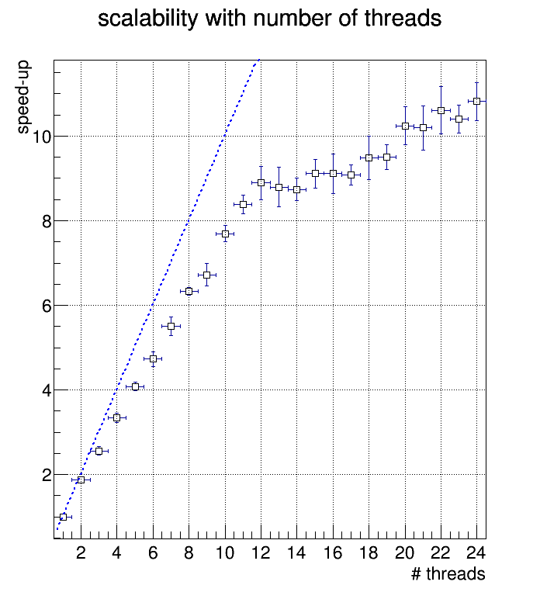
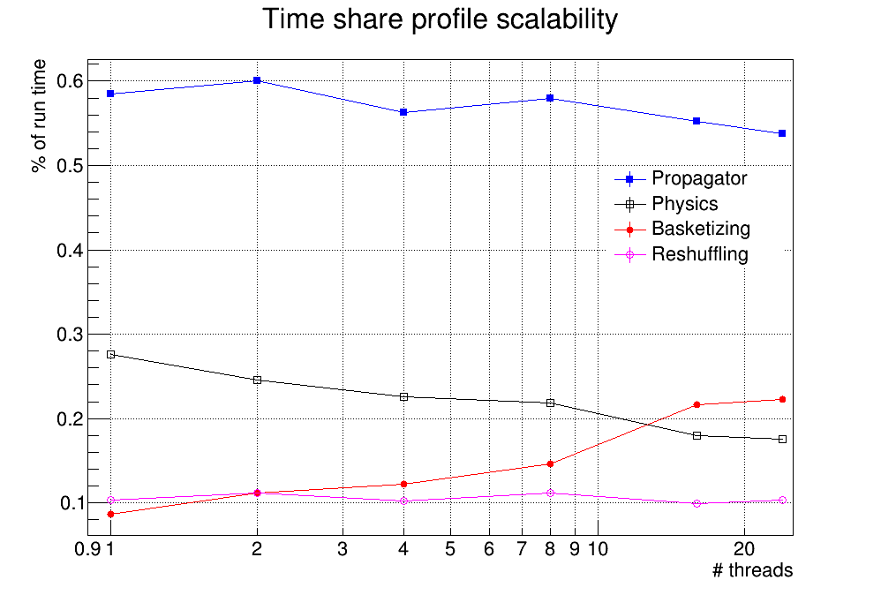
Challenges
  No free lunch: need to keep data gathering overheads < vector gains
Run-time fraction spent in different parts of GeantV
Geometry
24-core dual socket E5-2695 v2 @ 2.40GHz (HSW).
Notes:
Basketizing is the most important operation generating concurrency cost, but the overhead by data copying is larger than 20%. Q1: can we reduce? -> Yes, by handling AOS, Q2: Is the overhead lesser than benefits? -> Yes, but only after being demonstrated by benchmarks. Concurrency on top of SOA is not so efficient due to the long time taken by copying all track fields, introducing also a lot of false sharing.

Slide 7
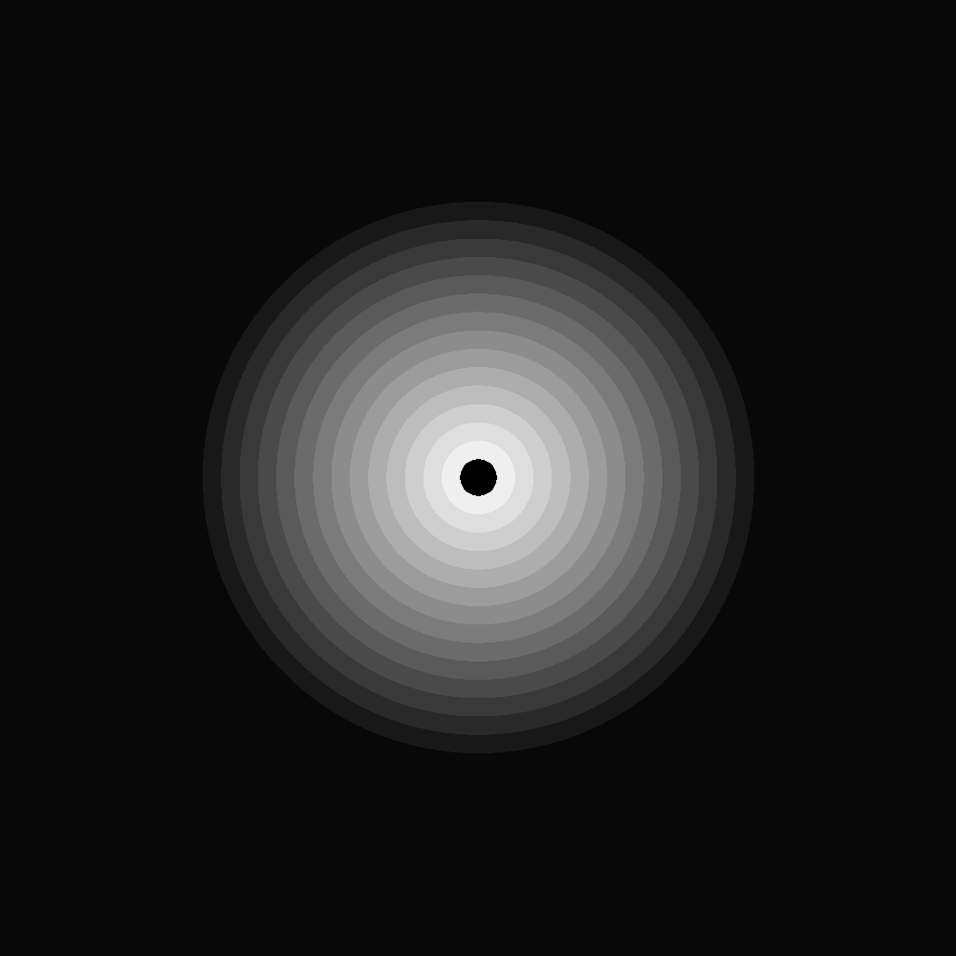
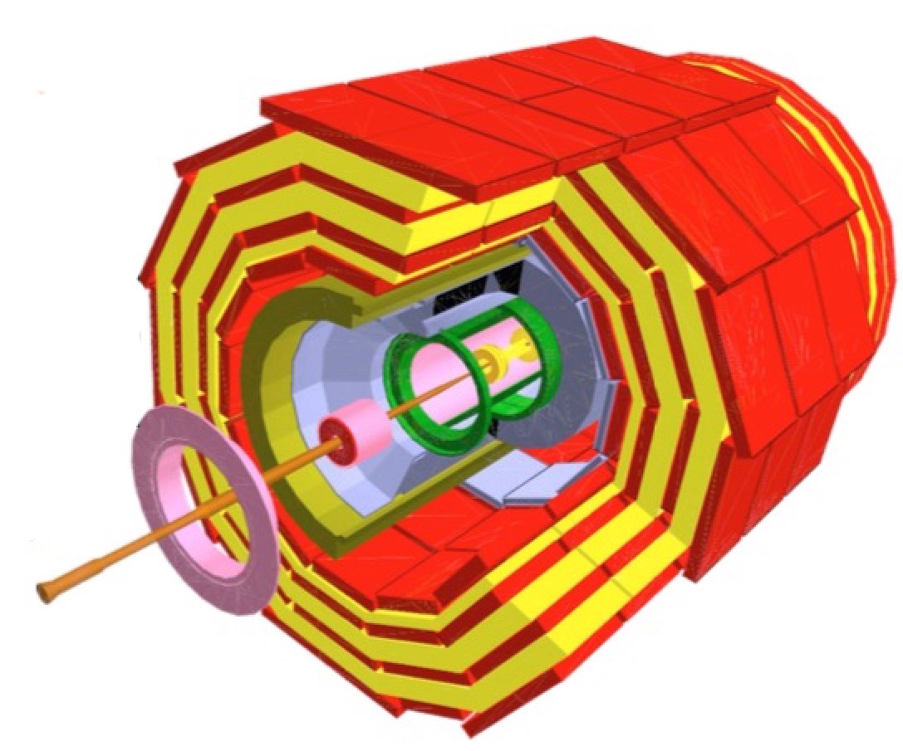
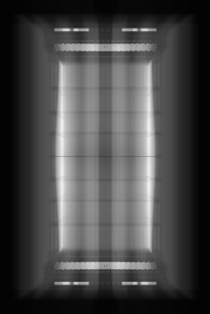
Geometry navigation on KNL
X-ray scan of detector volumes
  Trace a grid of virtual rays through geometry
Simplified geometry emulating a tracker detector
Compare GeantV basket approach to
  Classical scalar navigation (ROOT)
  An ideal “vector” case (no basketizing overheads)
AVX512 vectorization enforced by API (UME:SIMD backend)
~100x scalability for the ideal and basket versions
Intel® Xeon Phi™ CPU 7210 @ 1.30GHz
Notes:
Mention that scalability issues are due to basketization procedure

Slide 8
Performance
  GeantV gives excellent benefits with respect to ROOT in terms of speedup
High vectorization intensity achieved for both ideal and basketized cases
  AVX-512 brings an extra factor of ~2 to our benchmark

Slide 9
KNL R&D 2016
Sub-node clustering with multiple propagators
  Improve data/processing locality and reduce contention
TBB-based task based version
Full prototype on KNL ( tabulated physics)
Improved memory management in basketizing procedure
(NUMA awareness)

Slide 10
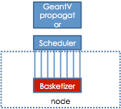
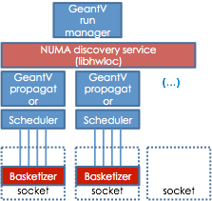
Sub-node clustering
Known scalability issues of full GeantV due to synchronization in re-basketizing
New approach deploying several propagators clustering resources at sub-node level
Objectives: improved scalability at the scale of KNL and beyond, address both many-node and multi-socket (HPC) modes + non-homogenous resources
Implemented recently and tested on KNL

Slide 11
Multi-propagators prototype
Full track transport and basketization procedure
              Simplified calorimeter
        Tabulated physics (EM processes + various materials)
Scalability gets better by increasing number of propagators
The seed for GeantV core version 3
Good scalability up to the number of physical cores

Slide 12
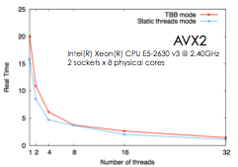
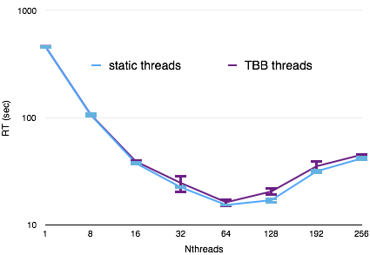
Task based GeantV
A first implementation of TBB task-based approach on the full track transport prototype
  Simplified detector geometry (calorimeter) + tabulated physics
Some overheads on Haswell/AVX2, not so obvious on KNL/AVX512
Less than 20% performance loss for the first implementation
Intel® Xeon Phi™ CPU 7210 @ 1.30GHz

Slide 13
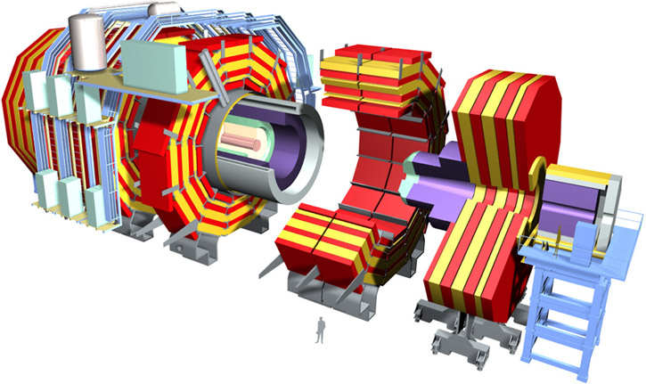
The full prototype
Exercise at the scale of LHC experiments (CMS)
        Full geometry + uniform magnetic field
Tabulated physics, fixed 1MeV energy threshold
Full track transport and basketization procedure
First results on scalability (comparison to classical approach single-thread)
Single thread: T_{classical}/T_{GV} ≈ 4.7

Slide 14
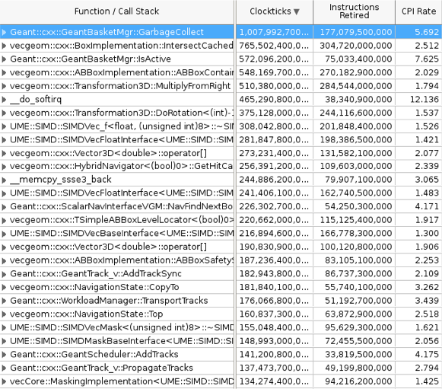
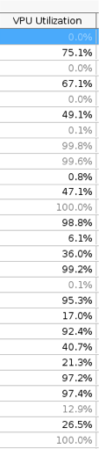

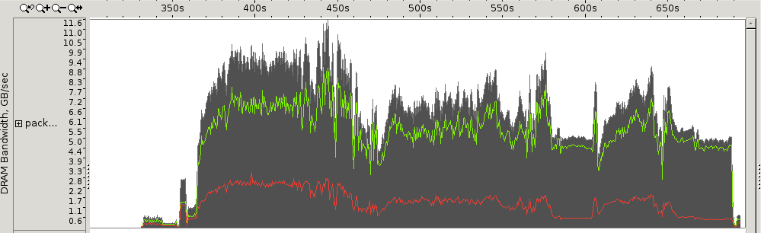
Full prototype performance on KNL
Overall we fill VPUs reasonably well
Memory access analysis shows we are not bandwidth bound: most of the code runs as “low utilisation”(<12 GB/sec)
Total GB/sec
Read GB/sec
Write GB/sec

Slide 15
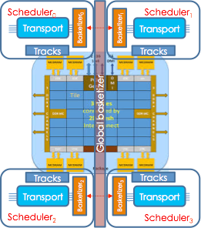
NUMA awareness
Replicate schedulers on NUMA clusters
  One basketizer per NUMA node
  libhwloc to detect topology
  Use pinning/NUMA allocators to increase locality
Multi-propagator mode running one/more clusters per quadrant
  Loose communication between NUMA nodes at basketizing step
  Implemented, currently being integrated

Slide 16
V3: A generic vector flow machine
scalar or basketized filters for all possible actions for the stage
e.g. ComptonFilter::DoIt
Simulation stages formalize the different steps in the track propagation algorithm
Handler (scalar)
scalar
virtual DoIt(track)
SimulationStage
SimulationStage
Handler (vectorized)
SimulationStage
vector
virtual DoIt( , )
virtual Select(track)
Basketizer
Stage buffer
Stage buffer
Follow-up
stage buffer
copy tracks
GeantTrack *
Stage buffer
loop
Process()
AddTrack(track, )
SimulationStage::fFollowUps[i]
Executor thread
Data owned by thread
empty baskets taken from tread pool

Slide 17
Processing flow per NUMA node
Event server
Stage buffers
Select
Select
Select
GeometryStage
PropagationStage
PhysicsStage
Linear prop.
Field prop.
Volume1
Volume2
Process1
Process2
Handlers
Basketizer
Basketizer
Basketizer
Basketizer
Scalar DoIt()
Vector DoIt()
Threads on same socket
Scalar code
Vectorized code

Slide 18
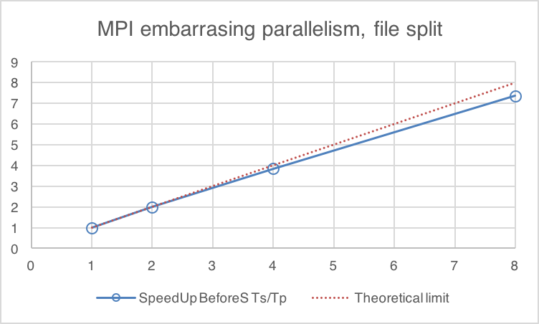
GeantV plans for HPC environments
R&D
Standard mode (1 independent process per node)
  Always possible, no-brainer
  Possible issues with work balancing (events take different time)
  Possible issues with output granularity (merging may be required)
Multi-tier mode (event servers)
  Useful to work with events from file, to handle merging and workload balancing
  Communication with event servers via MPI to get event id’s in common files
MPI
Node₁
Node₂
Node_{mod[N]}
Event feeder
Event feeder
Event server
Numa₀
Numa₁
Numa₀
Numa₁
Numa₀
Numa₁
Transport
Transport
Transport
Transport
Transport
Transport
Merging service
MPI
Node₁
Node₂
Node_{mod[N]}
Node₁
Node₂
Node_{mod[N]}
Event feeder
Event feeder
Event server
Event feeder
Event feeder
Event server
Numa₀
Numa₁
Numa₀
Numa₁
Numa₀
Numa₁
Numa₀
Numa₁
Numa₀
Numa₁
Numa₀
Numa₁
Transport
Transport
Transport
Transport
Transport
Transport
Transport
Transport
Transport
Transport
Transport
Transport
Merging service
Merging service

Slide 19
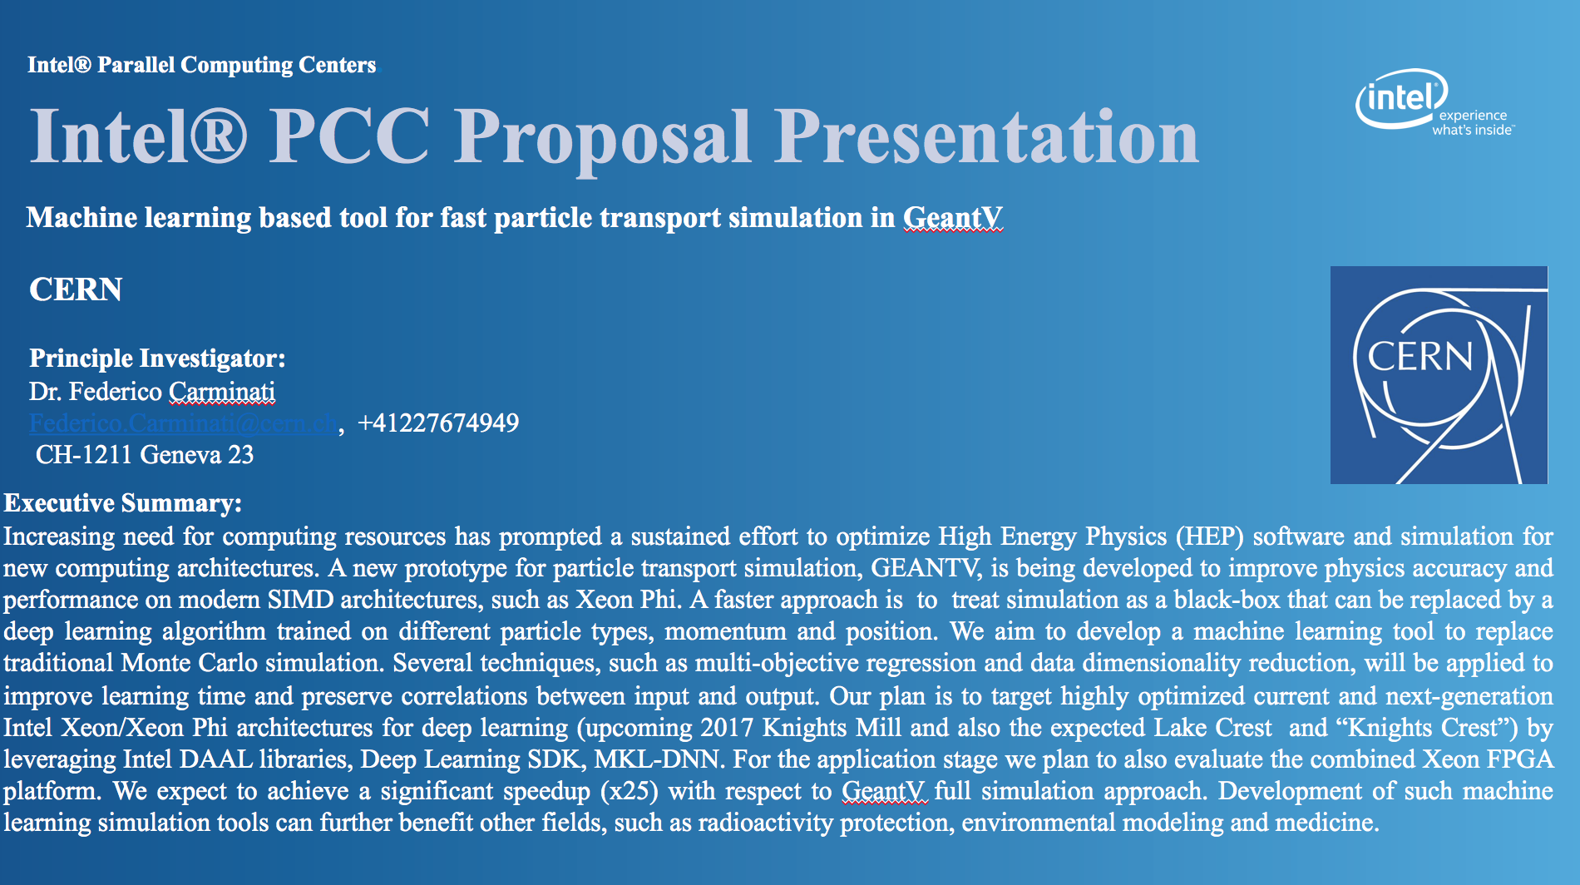

Slide 20
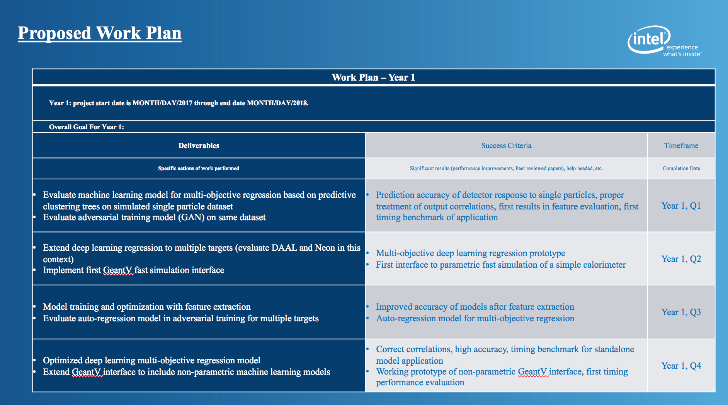

Slide 21
Alpha release of GeantV (Q4, 2017)
Version 3 of the scheduler
  Low overhead, scalable, AOS basketizing, new interfaces, new memory management (NUMA + shower burners)
  Design/interfaces cleanup, refactoring of concurrency tools as separate library
  Demonstrator for EM physics basketizing
  Task model working with CMSSW
  Efficient deployment on HPC clusters – R&D
Complete user interfaces (discussed with experiments)
  Full workflow simulation -> digitizers -> I/O stressing user interface (both standalone GeantV examples and TBB CMSSW)
  MC truth user hooks defined + most common use case demonstrators
Efficient vectorized RK propagator including optimizations (last field value, helix fallback)
Geometry with complete navigation features demonstrating vector gains (2017 release)
  Specialized navigators in action, including training/deployment model
EM physics: most(?) e+/e-/gamma models in scalar mode + some vector gains
  Integration of MSC, development/finalizing of ionization, bremsstrahlung, pair production, Compton, photoelectric
Hadronic x-sec from tables, Glauber-Gribov hadronic cross sections, Hadron elastic model, Part I
Fast simulation “hooks” a la G4 demonstrated to work in the basket flow
  Formalizing user interface, scope definition R&D, start development of a Multi-Objective regression tool
GPU demonstrator capable of doing complete simulation (e.g. CMS, no optimization)
Testing/validation suite and performance demonstrators vs. Geant4

Slide 22
Beta release of GeantV (Q4, 2018)
Production-quality scheduling, including error handling at the level of track/event
  Optimization based on integration with experiment frameworks (user interfaces, digitizers flow)
  Demonstrator for performance in HPC environments
  Tuning procedure for scheduling parameters based on ML/GA
Production-quality geometry (2018 release)
  Supporting all features of G4/ROOT, full set of shapes, demonstrators for all 4 LHC experiments
  Extended validation suite, robustness demonstration
Demonstrator for efficient MC truth usage, based on realistic use cases from experiments
Full EM shower physics, most CPU-consuming models vectorized
  Benchmarks demonstrating vector mode and speedup compared to G4 equivalent
Hadronics – hadronic elastic implemented + QGS part I
  Complete model-level & application-level tests
Fast sim demonstrators for most common use cases
  Integration with experiment frameworks
  Demonstrator for the full learn/replay procedure – ML standalone tool + performance study for different detectors

Slide 23
Conclusion and insights
GeantV delivers already a part of the expected performance on KNL
  Many optimization requirements, now understanding how to handle most of them
Additional levels of locality (NUMA) available: topology detection already in GeantV, currently being integrated
Exploring task-based approach: TBB-enabled version is ready
Next step: V3 core in production, integration with physics and optimization
2017 & 2018 – ambitious program of work, aiming to releasing a product having most of the target features to experiments

