Slide 1
GeantV – From CPU to accelerators
Philippe Canal (FNAL) for the GeantV development team
G.Amadio (UNESP), Ananya (CERN), J.Apostolakis (CERN) , A.Arora (CERN), M.Bandieramonte (CERN), A.Bhattacharyya (BARC), C.Bianchini (UNESP), R.Brun (CERN), Ph.Canal (FNAL), F.Carminati (CERN), L.Duhem (intel), D.Elvira (FNAL), A.Gheata (CERN), M.Gheata (CERN), I.Goulas (CERN), R.Iope (UNESP), S.Y.Jun (FNAL), G.Lima (FNAL), A.Mohanty (BARC), T.Nikitina (CERN), M.Novak (CERN), W.Pokorski (CERN), A.Ribon (CERN), R.Sehgal (BARC), O.Shadura (CERN), S.Vallecorsa (CERN), S.Wenzel (CERN), Y.Zhang (CERN)

Slide 2
Outline
GeantVectorized – an introduction
Challenges, ideas, goals
Main components and performance
Design and infrastructure
Vectorization: overheads vs. gains
Geometry library
Physics processes
Performance benchmarks
Results, milestones, plans

Slide 3
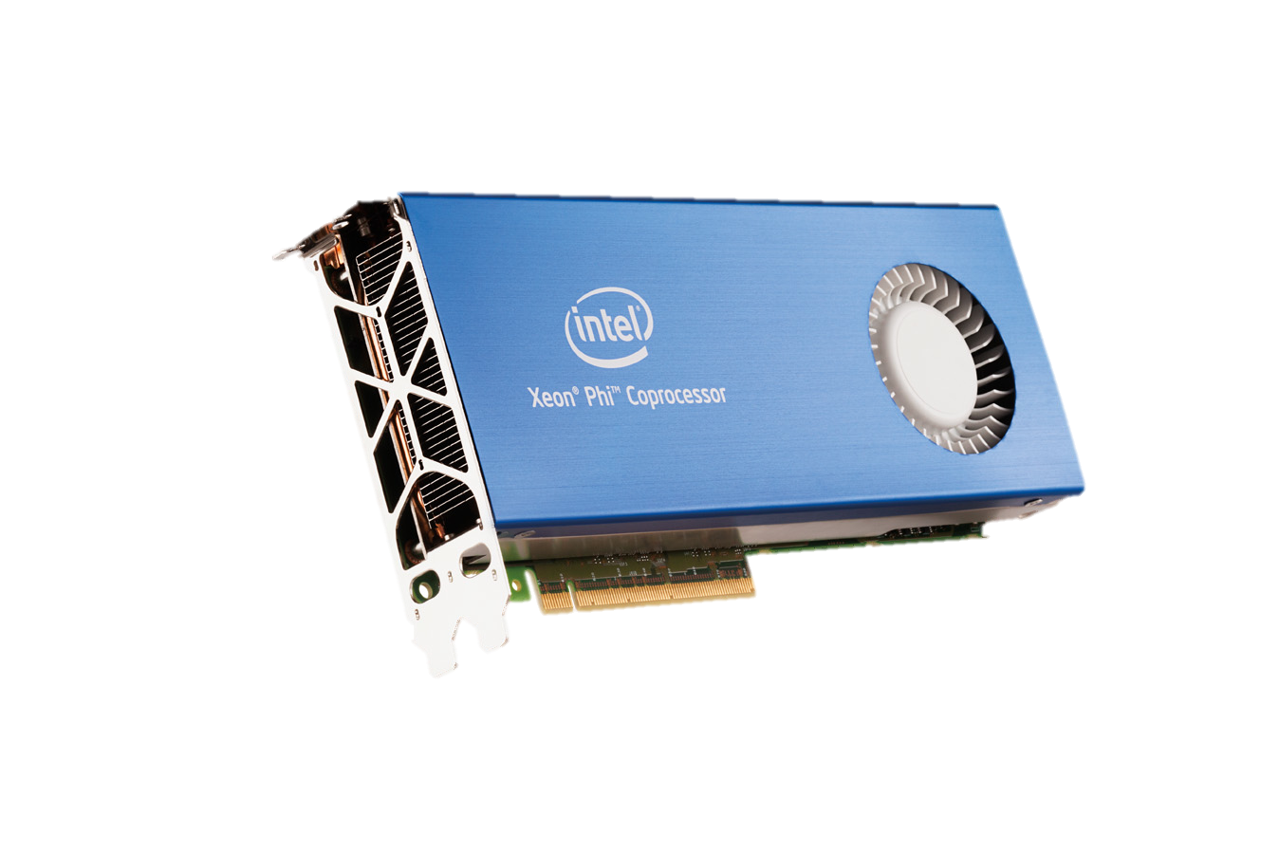
Geant4 Multi-threading
Event level Parallelism
Each thread processes one full event exclusively
Part of Geant4 since release 10.0, Dec. 2013
Demonstrates
Linear scaling of throughput with number of threads
Large savings in memory: 9MB extra memory per thread
No Performance/Throughput increase
Preliminary, Courtesy of A.Dotti, SLAC

Slide 4
What do we want to do?
Develop an all-particle transport simulation software with
Geant4 or new improved (where possible) physics models
A performance between 2 and 5 times greater than Geant4
Full simulation and various options for fast simulation
Portable on different architectures, including accelerators (GPUs and Xeon Phi’s)
Understand the limiting factors for a one-order-of-magnitude (10x) improvement

Slide 5
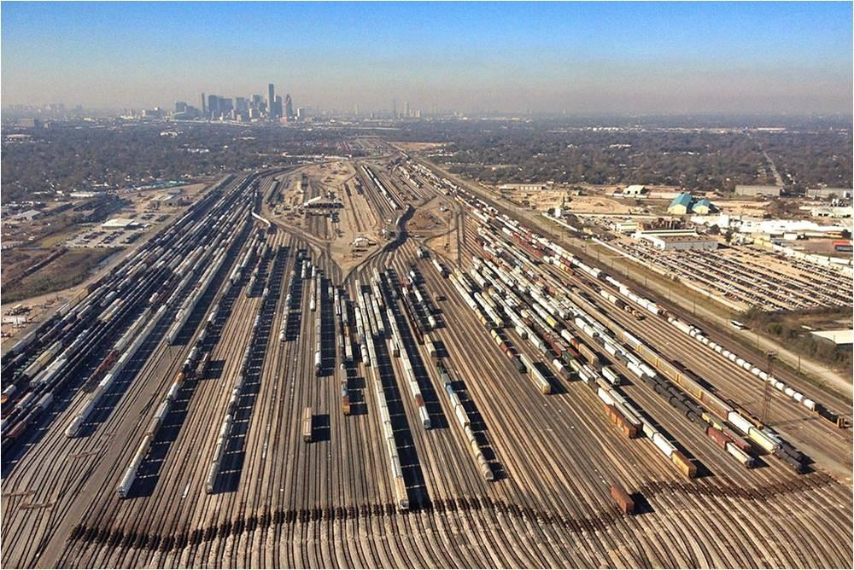
The ideas
Transport particles in groups (vectors) rather than one by one
Group particles by geometry volume or same physics
No free lunch: data gathering overheads < vector gains
Dispatch SoA to functions with vector signatures
Use backends to abstract interface: vector, scalar
Use backends to insulate technology/library: Vc, Cilk+, VecMic, …
Redesign the library and workflow to target fine grain parallelism
CPU, GPU, Phi, Atom, …
Aim for a 3x-5x faster code, understand hard limits for more

Slide 6
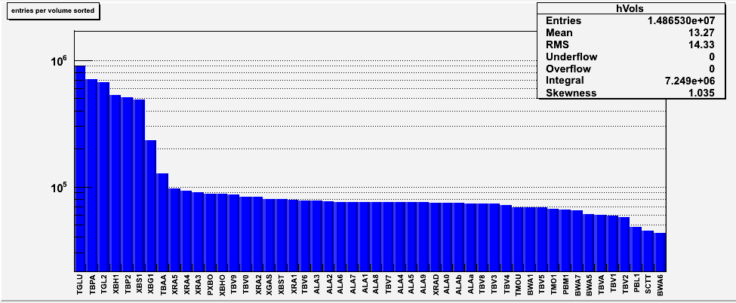
HEP transport is mostly local !
Locality not exploited by the classical transport
Existing code inefficient (0.6-0.8 IPC)
Cache misses due to fragmented code
50 per cent of the time spent in 50/7100 volumes
ATLAS volumes sorted by transport time. The same behavior is observed for most HEP geometries.

Slide 7
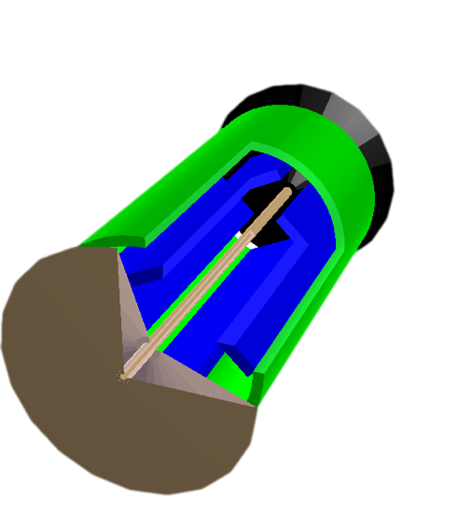
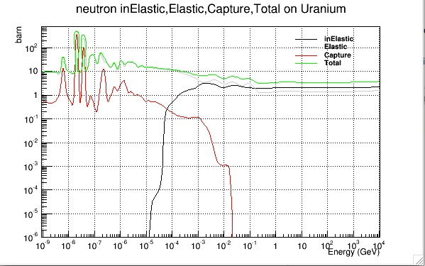
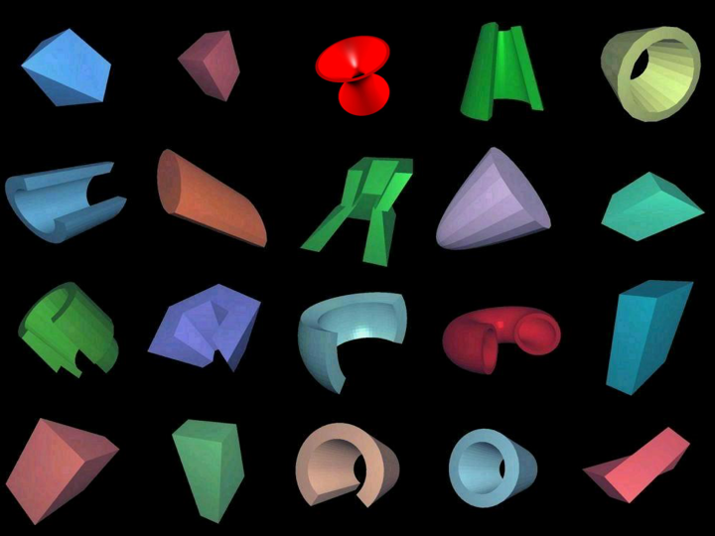
Scheduler
The initial ideas sounded easy
Basket of tracks
Basket of tracks
Dispatching
MIMD
SIMD
Geometry navigator
Physics
Geometry algorithms
x-sections
Reactions

Slide 8
Challenges
Overhead from reshuffling particle lists should not offset SIMD gains
Exploit the hardware at its best, while maintaining portability
Test from the onset on a “large” setup (LHC-like detector)
Toy models tell us very little – complexity is the problem
Scheduler
CPU
GPU
Phi
Atom
XXX

Slide 9
Status on GPU
Broker adapts baskets to the coprocessor
Selects tracks that are efficiently processed on coprocessor
Gather in chunk large enough (e.g. 4096 tracks on NVidia K20)
Transfer data to and from coprocessor
Execute kernels
On NVidia GPU, we are effectively using implicit vectorization
Rather than one thread per basket, on GPUs we use 4096 threads each processing one of the tracks in the basket
Cost of data transfer is mitigated by overlapping kernel execution and data transfer
We can send fractions of the full GPU's work asynchronously using streams

Slide 10
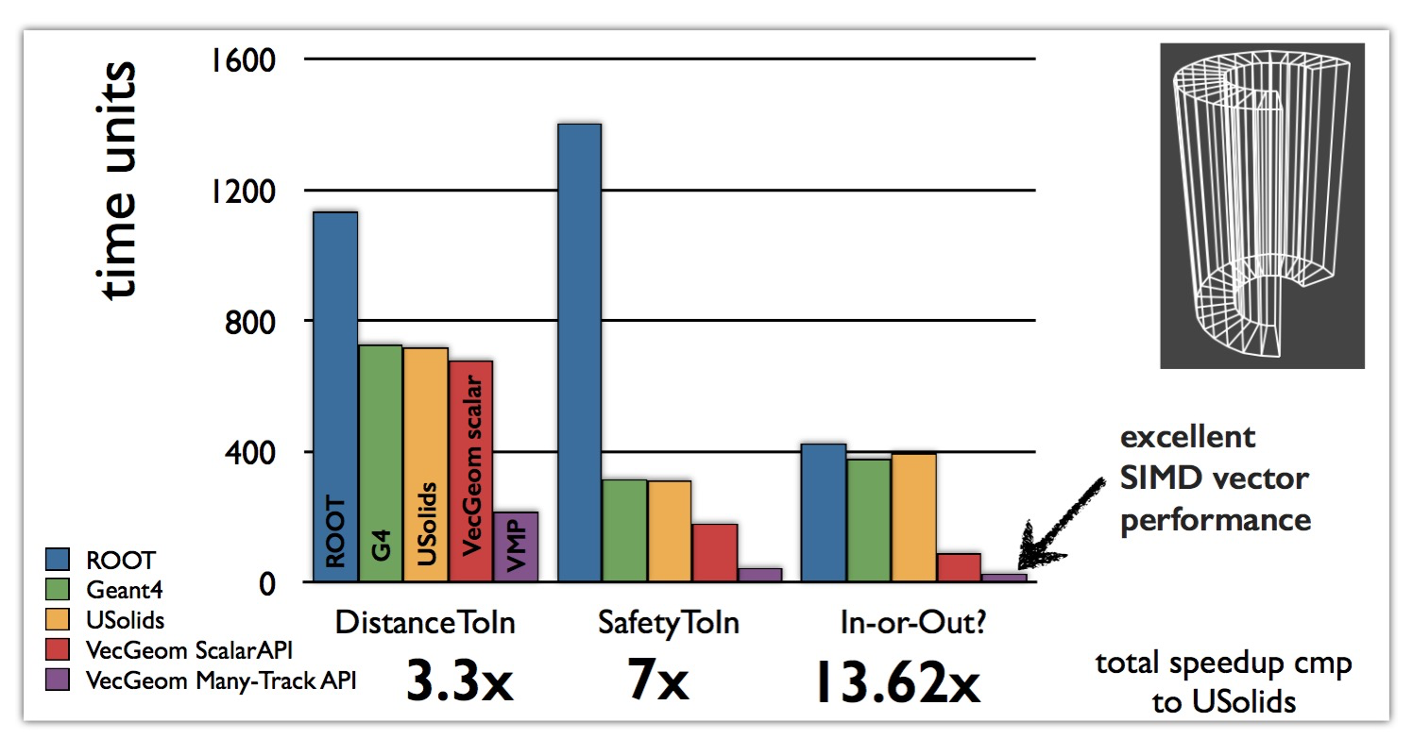
Geometry - VecGeom
Geometry takes 30-40% CPU time of typical Geant4 HEP Simulation
A library of vectorised geometry algorithms to take maximum advantage of SIMD architectures
Substantial performance gains also in scalar mode
Better scalar
code

Slide 11
Evolution
One becomes two, two becomes three, and out of the third comes the one as the fourth. Maria Prophetissa (3rd century AD)
VecGeom code has been developed for GeantV vectorised transport
USolids was developed to unify TGeo and Geant4 geometry packages
Now VecGeom algorithms are retrofitted to USolids and are available both to Geant4 and to TGeo
VecGeom has the potential to introduce a few percent gain for Geant4 (to be verified)
Algorithm improvement and (internal) vectorisation of some shapes
VecGeom is the consolidation both on the algorithm level and on the developer level of G4-Geo, TGeo, USolid and Vectorization efforts.

Slide 12
Portability
“Backend” is a (trait) struct encapsulating standard types/properties for “scalar, vector, CUDA” programming; makes information injection into template function easy
Long-term maintainability of the code
write one single version of each algorithm and to specialise it to the platform via template programming and low level optimised libraries (Vc in our case)
A Xeon Phi specific backend is being developed in collaboration with CERN’s openlab (UME::SIMD)
Results are quite encouraging: maybe portable HPC is NOT an oxymoron after all…
1 particle API
Many particle API (SIMD)
Common C++ template functions
double distance( double );
Vc::double_v distance( Vc::double_v );
template<class Backend>
Backend::double_t
common_distance_function( Backend::double_t input )
{
// Algorithm using Backend types
}
struct ScalarBackend
{
typedef double double_t;
typedef bool bool_t;
static const bool IsScalar=true;
static const bool IsSIMD=false;
};
struct VectorBackend
{
typedef Vc::double_v double_t;
typedef Vc::bool_v bool_t;
static const bool IsScalar=false;
static const bool IsSIMD=true;
};
http://code.compeng.uni-frankfurt.de/projects/vc

Slide 13
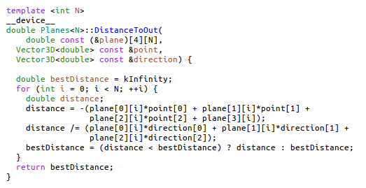
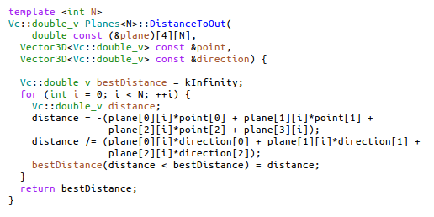
Avoiding code duplication
cuda
Support of multiple platforms usually means multiple versions of source code
What are the differences between the two versions of code shown on the right?
Primarily: types and their operators, function attributes (__device__), also some higher level functions, e.g. conditional assignment
Avoid code duplication by abstracting away differences into common types or overloaded functions defined in trait structures.
Vc
Notes:
3/31/16
13
13

Slide 14
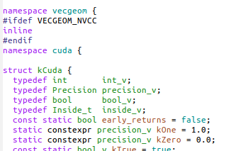
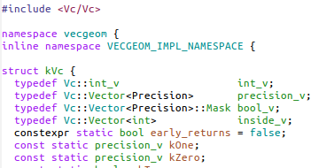
Using traits to avoid code duplication
backend/cuda/Backend.h
Intensive kernels are developed in a generic way, using only trait-defined types and functions.
Architecture-specific traits are created as needed, to associate generic types and functions with their arch-specific types.
Appropriate backends are requested by #define
backend/vc/Backend.h
Notes:
3/31/16
14
14

Slide 15
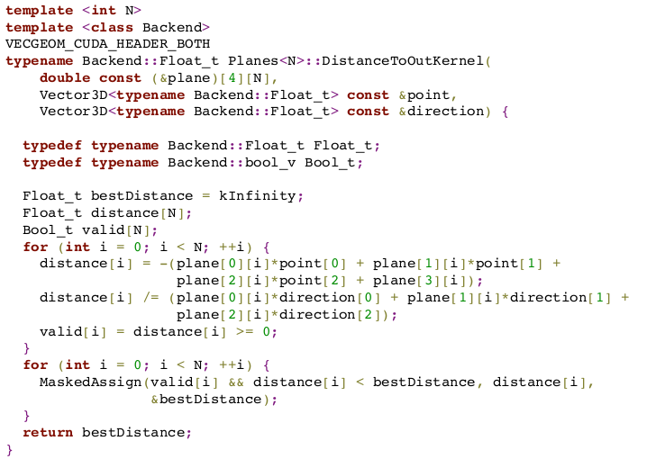
A generic kernel
The Backend, as discussed
Arithmetics just works!
MaskedAssign( ) is an optimized if( ) replacement
Notes:
3/31/16
15
15

Slide 16
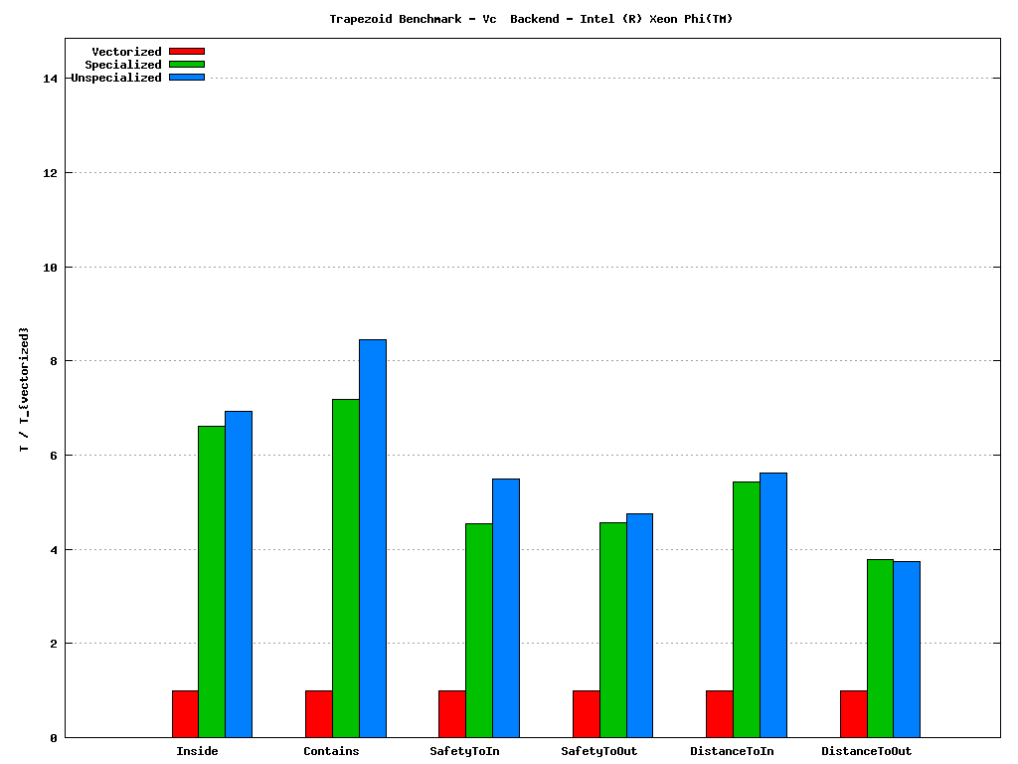
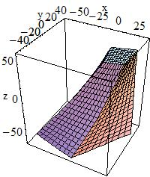
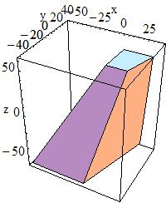
Geometry performance (Phi vs Xeon)
Geometry is 30-40% of the total CPU time in Geant4
A library of vectorized geometry algorithms to take maximum advantage of SIMD architectures
Substantial performance gains also in scalar mode
Testing the same also on GPU
 | 16 particles | 1024 particles | SIMD max
Intel Ivy-Bridge (AVX) | ~2.8x | ~4x | 4x
Intel Haswell (AVX2) | ~3x | ~5x | 4x
Intel Xeon Phi (AVX-512) | ~4.1 | ~4.8 | 8x
Overall performance for a simplified detector vs. scalar ROOT/5.34.17
Vectorization performance for trapezoid shape navigation (Xeon®Phi® C0PRQ-7120 P)

Slide 17
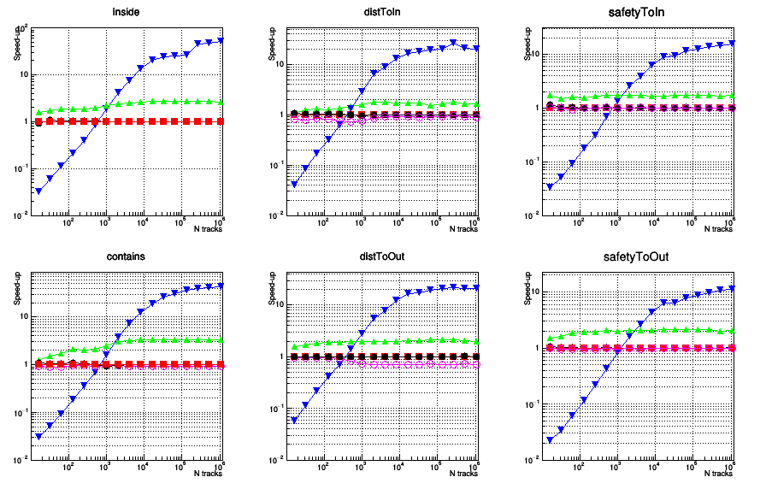
Geometry performance on K20
Speedup for different navigation methods of the box shape, normalized to scalar CPU
Scalar (specialized/unspecialized)
Vector
GPU (Kepler K20)
ROOT
Data transfer in/out is asynchronous
Measured only the kernel performance, but providing constant throughput can hide transfer latency
The die can be saturated with both large track containers, running a single kernel, or with smaller containers dynamically scheduled.
Just a baseline proving we can run the same code on CPU/accelerators, to be optimized

Slide 18
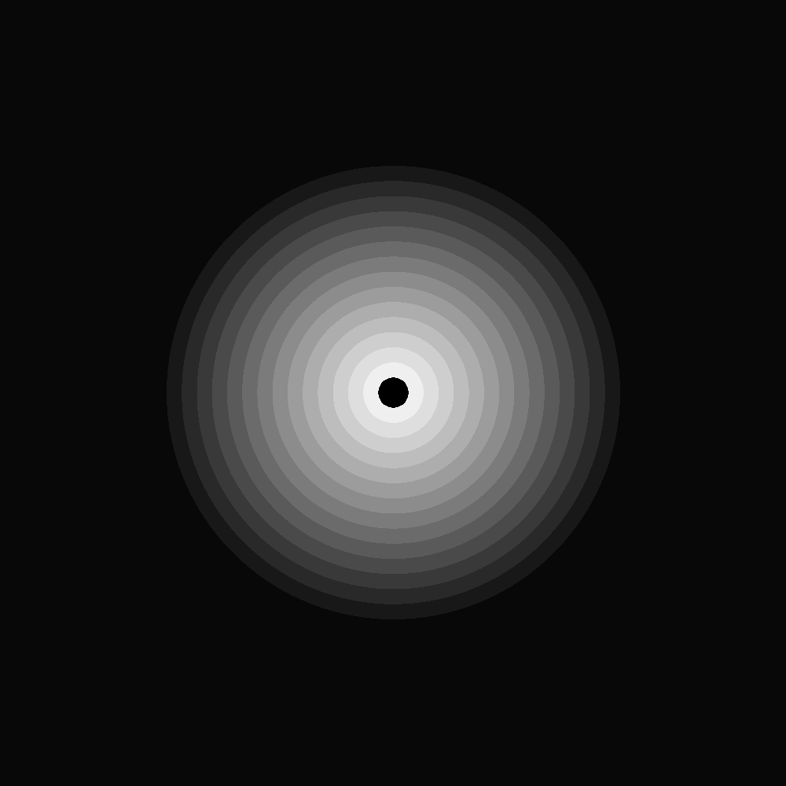
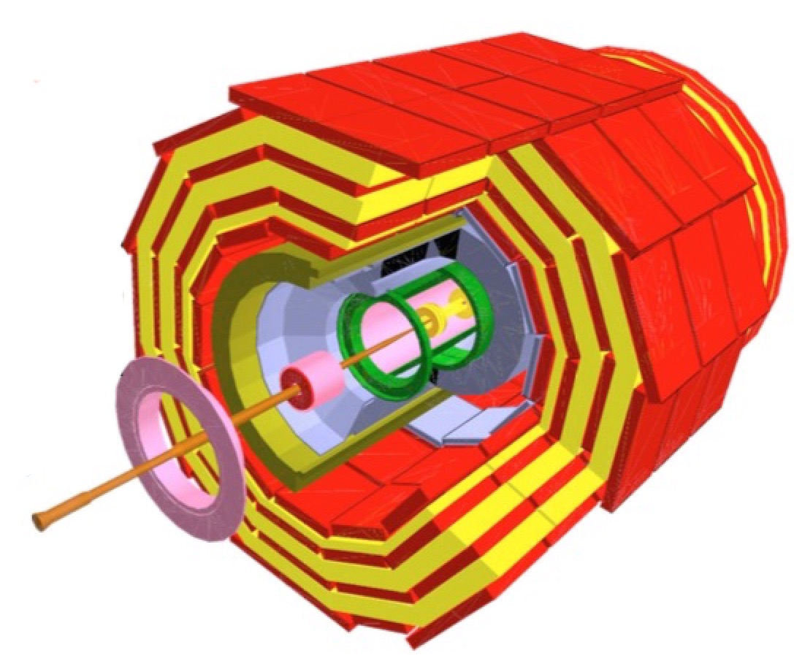
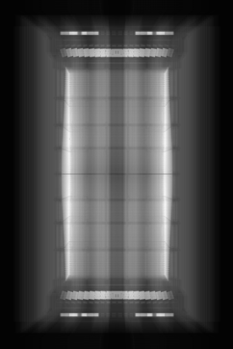
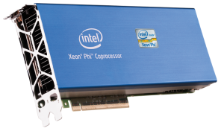
The X-Ray benchmark
The X-Ray benchmark tests geometry navigation in a real detector geometry
X-Ray scans a module with virtual rays in a grid corresponding to pixels on the final image
Each ray is propagated from boundary to boundary
Pixel gray level determined by number of crossings
A simple geometry example (concentric tubes) emulating a tracker detector used for Xeon©Phi benchmark
To probe the vectorized geometry elements + global navigation as task
OMP parallelism + “basket” model
OMP threads

Slide 19
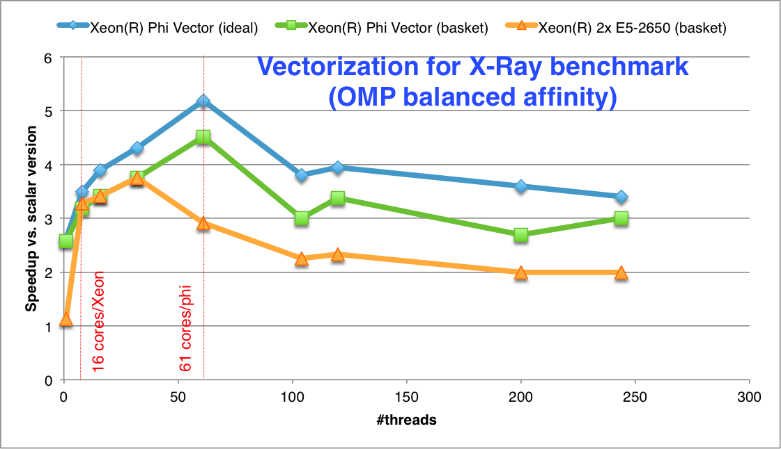
Vector performance
Gaining up to 4.5 from vectorization in basketized mode
Approaching the ideal vectorization case (when no regrouping of vectors is needed)
Vector starvation starts when filling more thread slots than the core count
Performance loss is not dramatic
Better vectorization compared to the Sandy-Bridge host (expected)
Scalar case: Simple loop over pixels
Ideal vectorization case: Fill vectors with N times the same X-ray
Realistic (basket) case: Group baskets per geometry volume

Slide 20
What about physics?
Needed a “reasonable” shower development
Developed a library of sampled interactions and tabulated x-sections for GeantV
Back ported to Geant4 for verification and comparison
A quick tool for developing realistic showers
Potentially for developing into a fast simulation tool

Slide 21
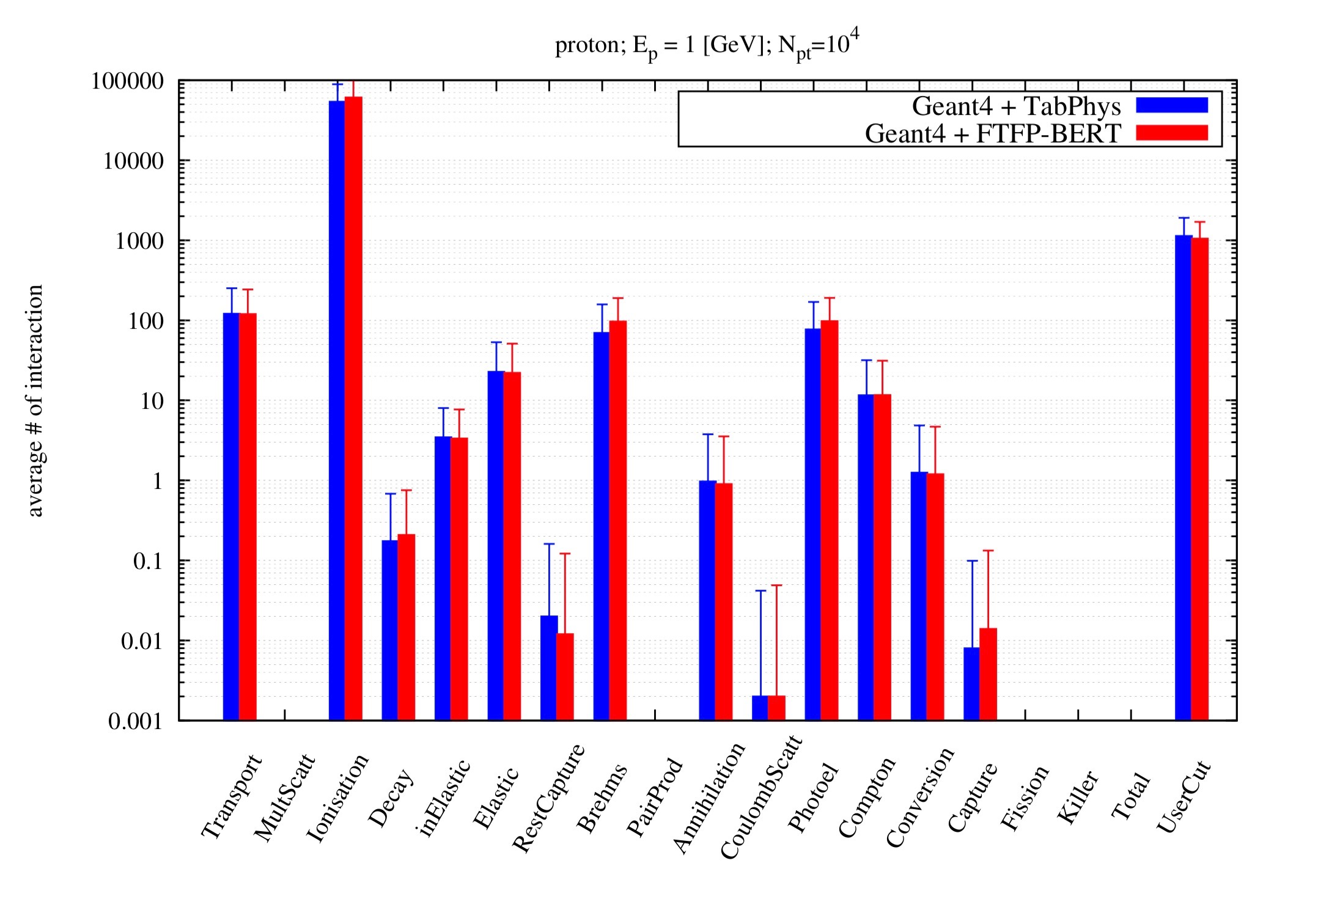
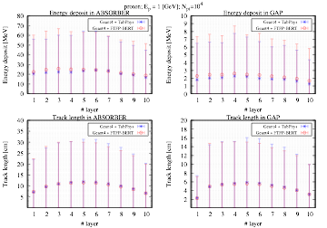
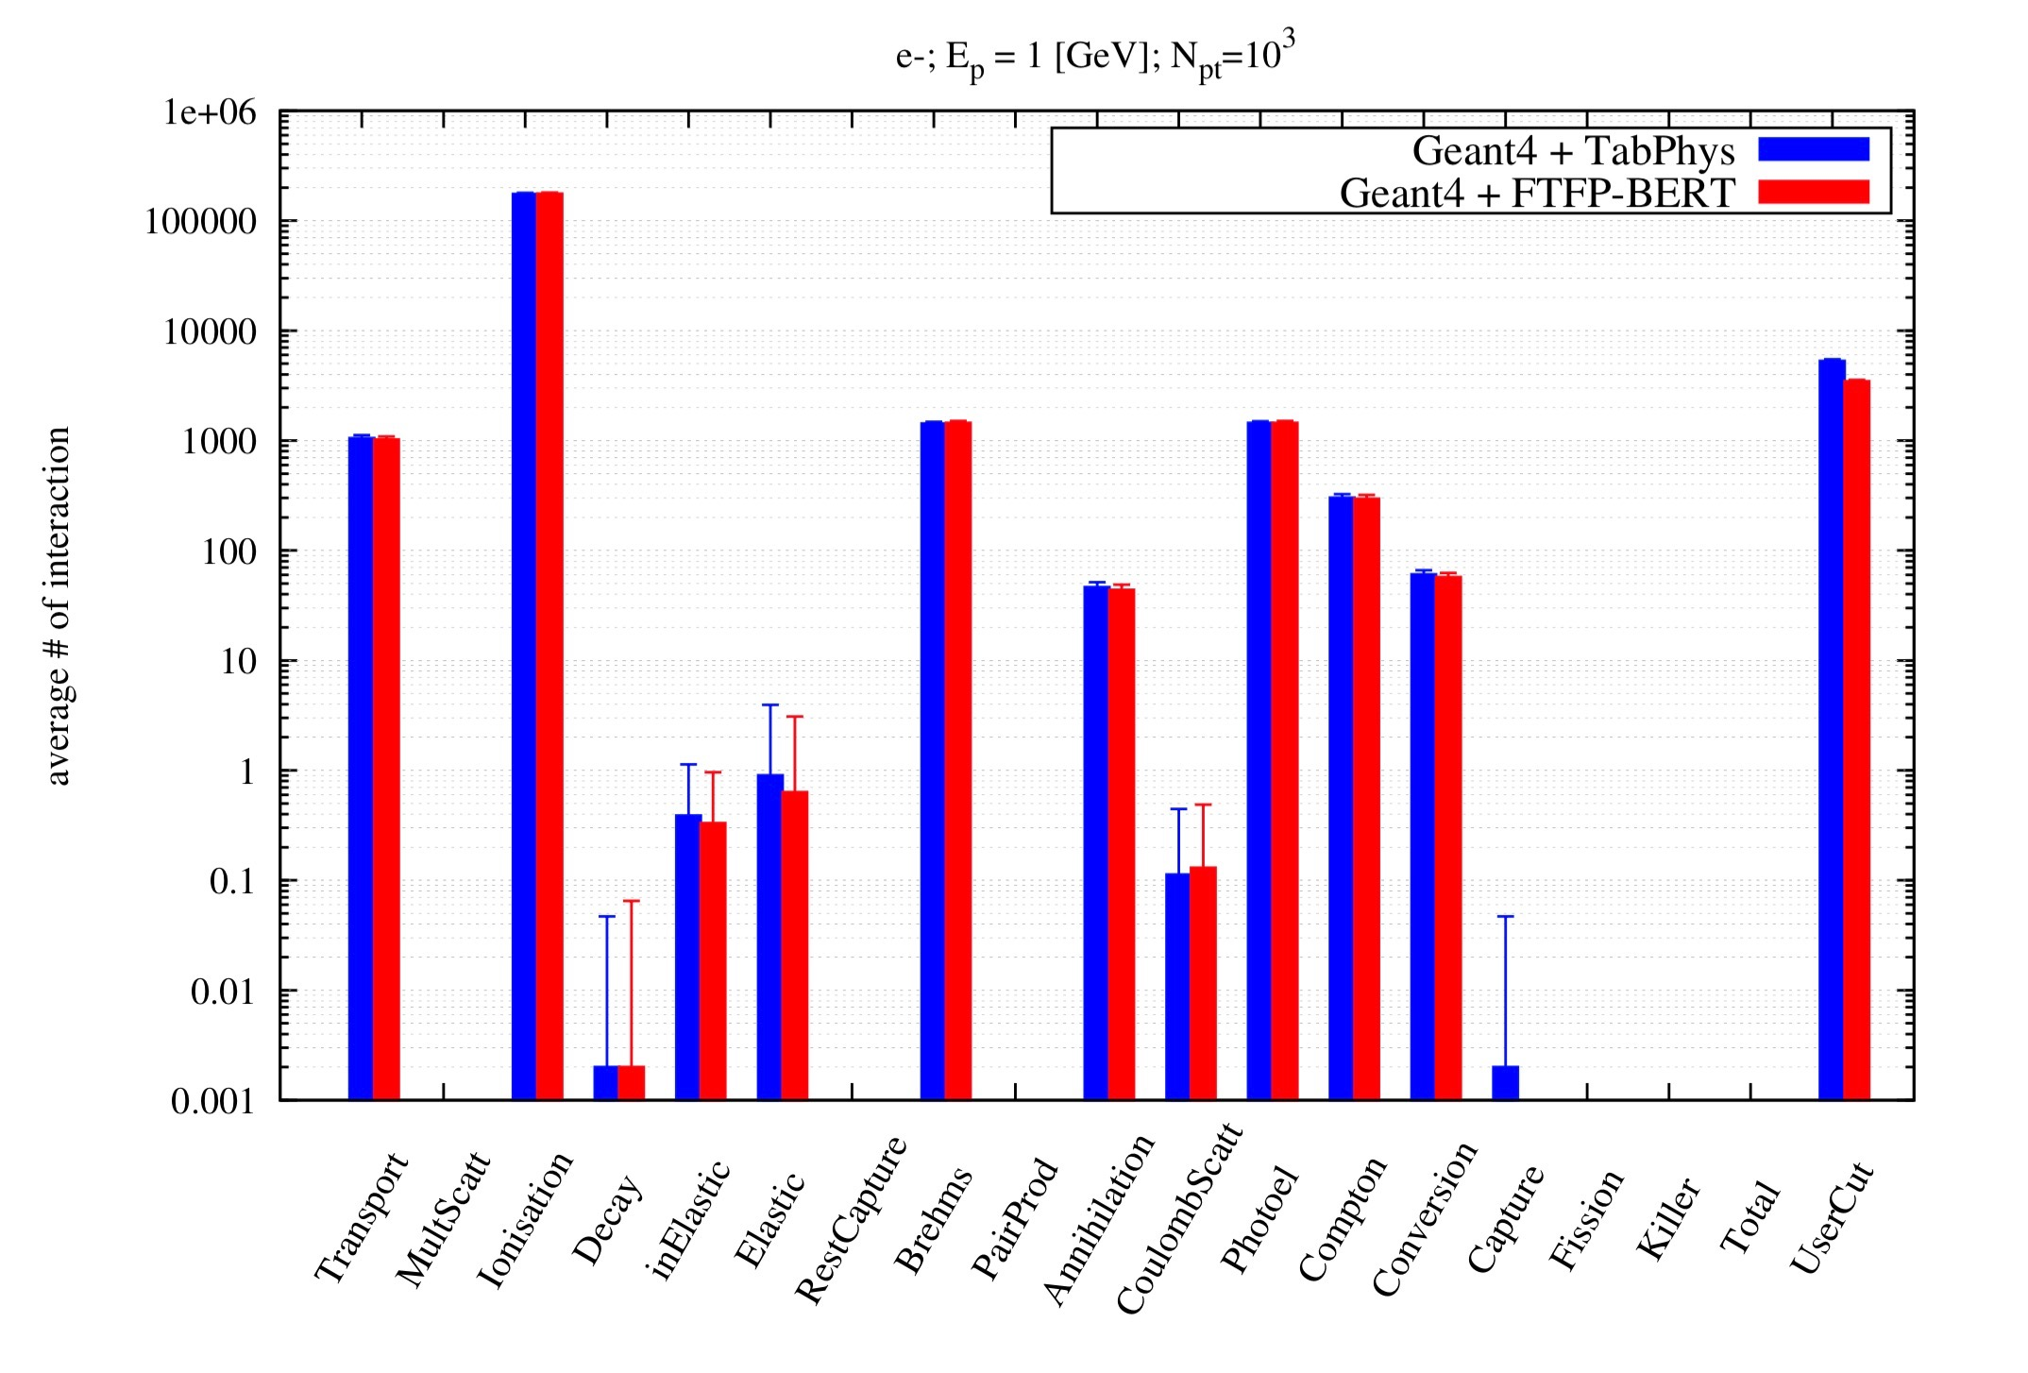
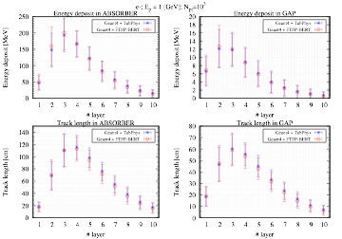
G4 example N03 vs tabulation (simple calo with many slabs)
FTFP-BERT
profile
histos

Slide 22
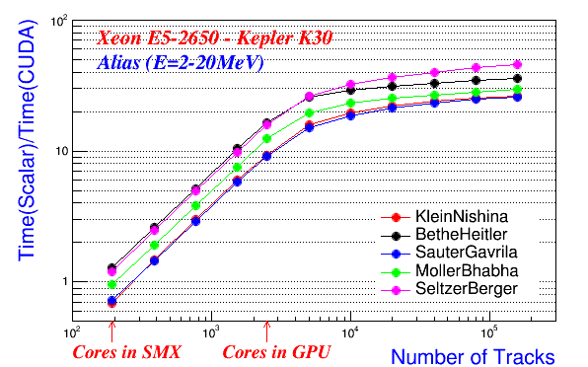
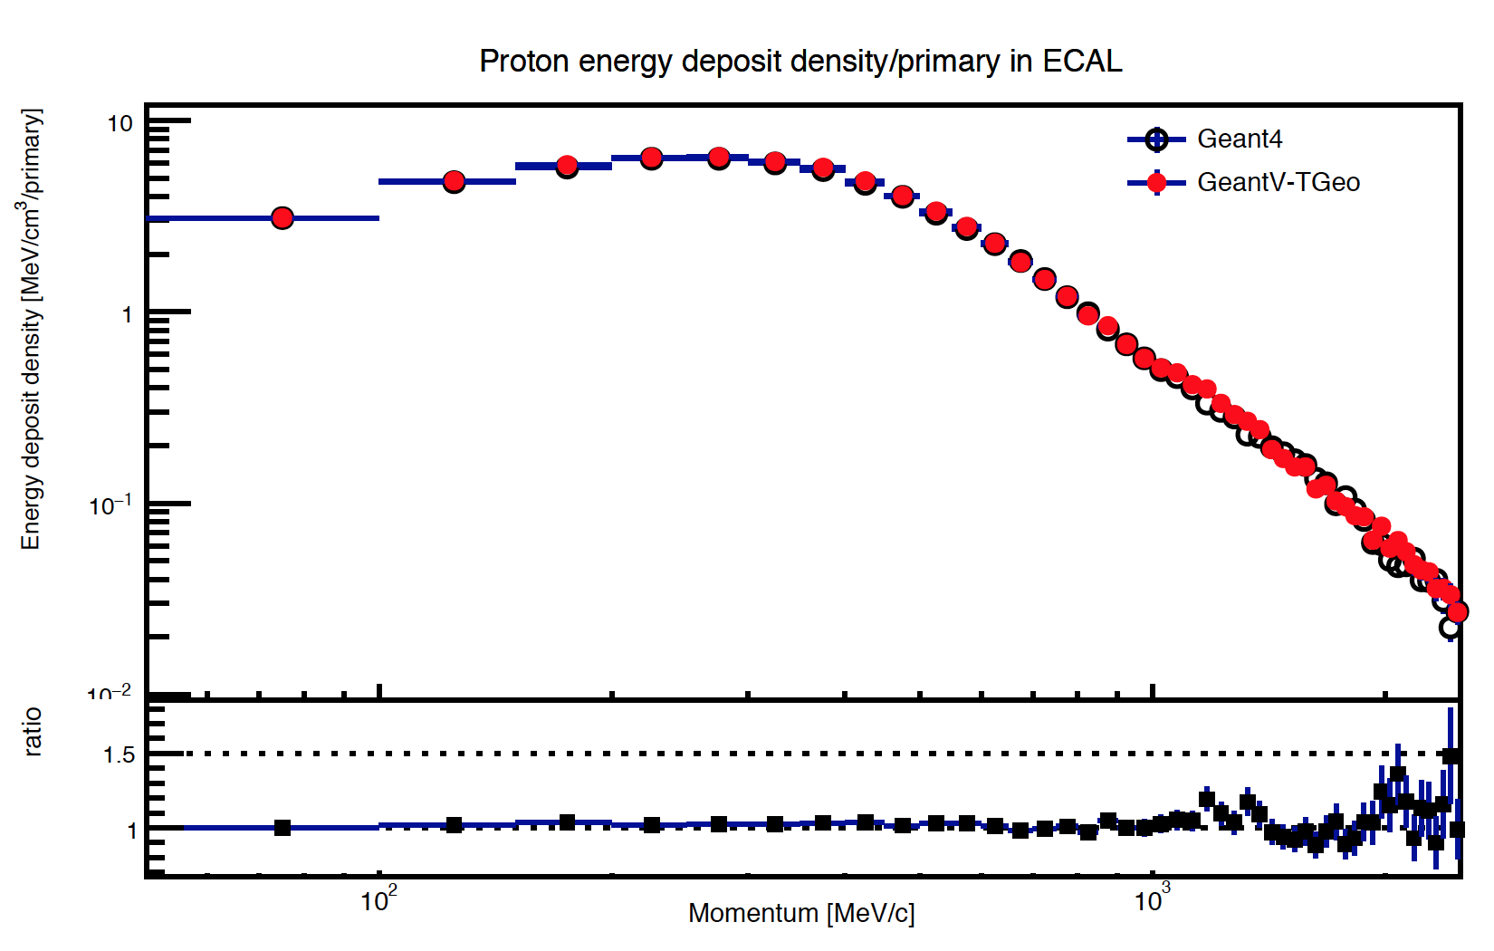
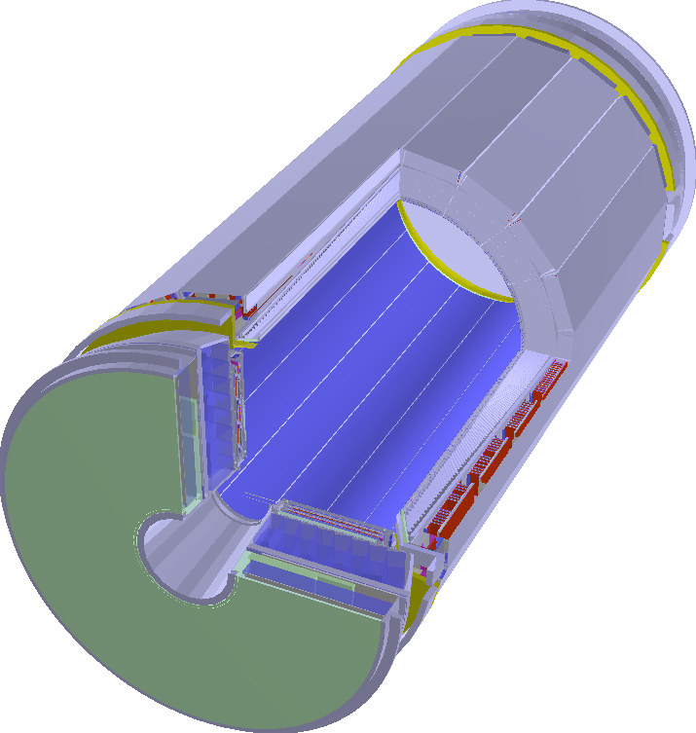
Physics Performance
Objective: a vector/accelerator friendly re-write of physics code
Started with the electromagnetic processes
The vectorised Compton scattering shows good performance gains
Current prototype able to run an exercise at the scale of an LHC experiment (CMS)
Simplified (tabulated) physics but full geometry, RK propagator in field
Very preliminary results needing validation, but hinting to performance improvements of factors
CMS Ecal

Slide 23
GeantV Output
Physics simulation produces ‘hits’ i.e. energy depositions in the sensitive parts of the detector
Those hits are produced concurrently by all the simulation (TransportTracks) threads
Thread-safe queues have been implemented to handle asynchronous generation of hits by several threads
Dedicated Output thread transfers the data from the output queues to ROOT I/O

Slide 24
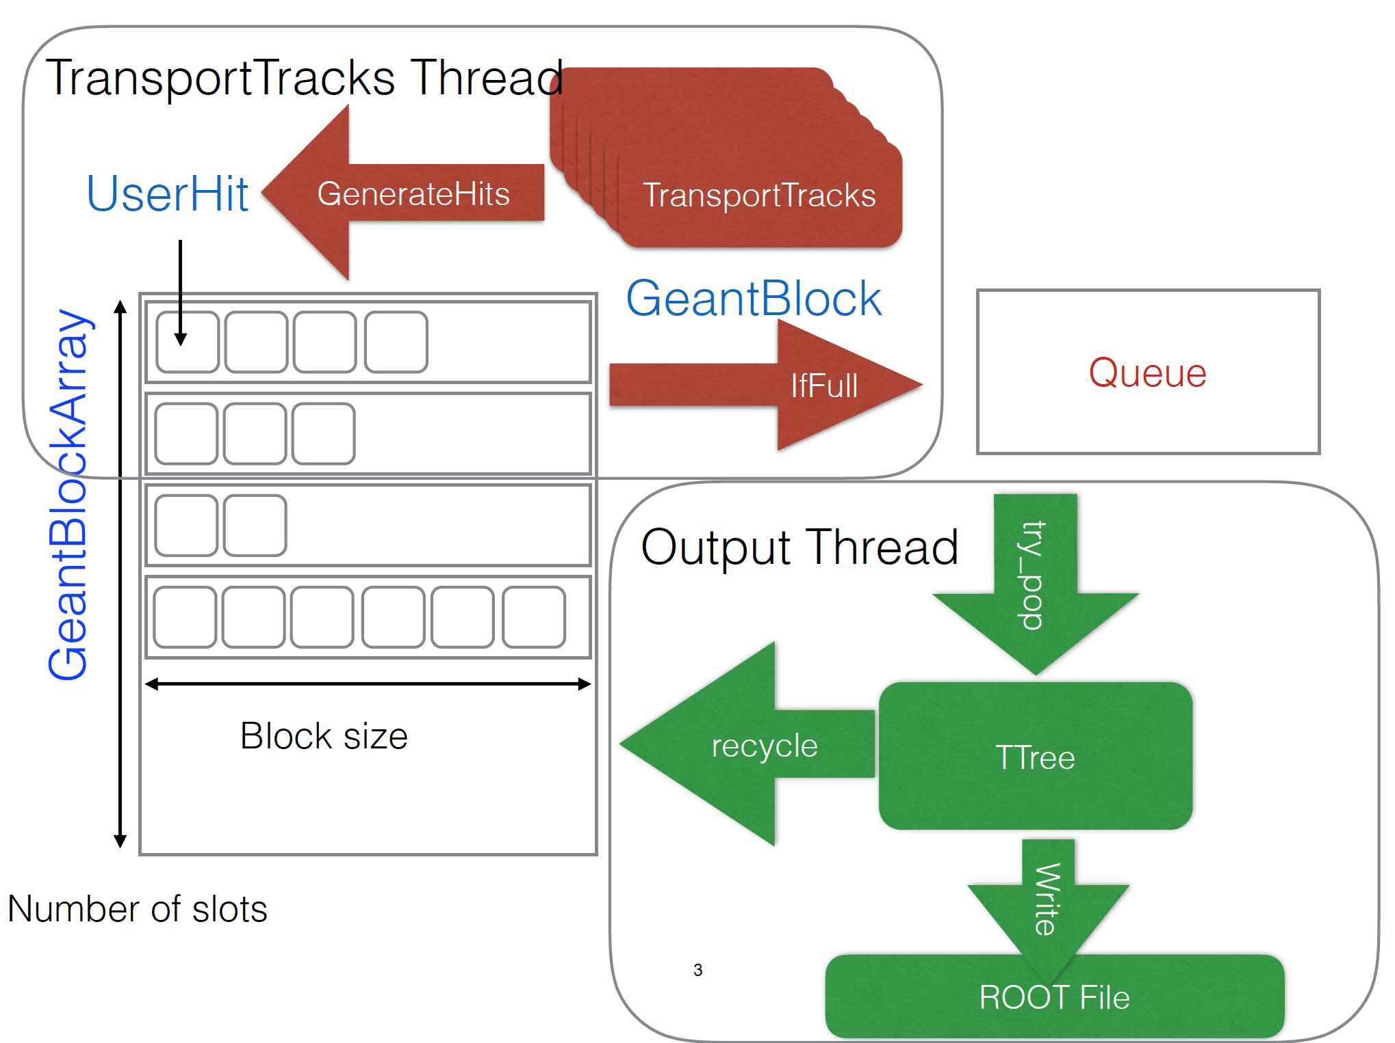
Hits/digits I/O
“Data” mode
Send concurrently data to one thread dealing with full I/O
Integrating user code with a highly concurrent framework should not spoil performance
“Buffer” mode
Send concurrently local trees connected to memory files produced by workers to one thread dealing with merging/write to disk

Slide 25
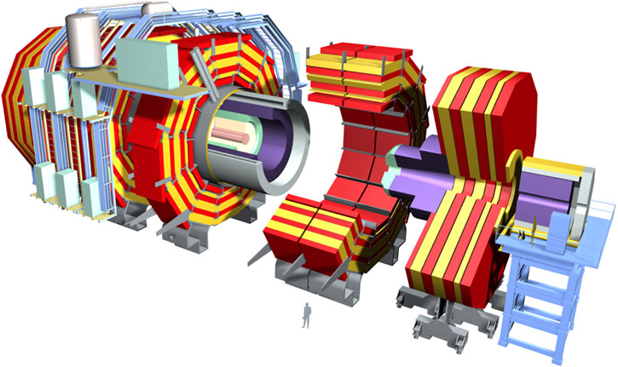
Yardstick: CMS With Tabulated Physics
Realistic Scale Simulation
pp collisions @ 14TeV minimum bias events produced by Pythia 8
2015 CMS detector
4T uniform magnetic field
Decent approximation of the real solenoidal field
Low energy cut at 1MeV
‘Tabulated’ Physics
Library of sampled interactions and tabulated x-sections
Same test (described above) run with both Geant4 and GeantV with various versions of the Geometry library.

Slide 26
Putting It All Together - CMS Yardstick
Semantic changes
Scheduler | Geometry | Physics | Magnetic Field Stepper
Geant4 only | Legacy G4 | Various Physics Lists | Various RK implementations
Geant4 or GeantV | VecGeom 2016 scalar | Tabulated Physics Scalar Physics Code | Helix Cash-Karp Runge-Kutta
GeantV only | VecGeom 2015 VecGeom 2016 vector Legacy TGeo | Vector Physics Code | Vectorized RK Implementation

Slide 27
Putting It All Together - CMS Yardstick
Semantic changes
Scheduler | Geometry | Physics | Magnetic Field Stepper
Geant4 only | Legacy G4 | Various Physics Lists | Various RK implementations
Geant4 or GeantV | VecGeom 2016 scalar | Tabulated Physics Scalar Physics Code | Helix (Fixed Field) Cash-Karp Runge-Kutta
GeantV only | VecGeom 2015 VecGeom 2016 vector Legacy TGeo | Vector Physics Code | Vectorized RK Implementation
3
2
1

Slide 28
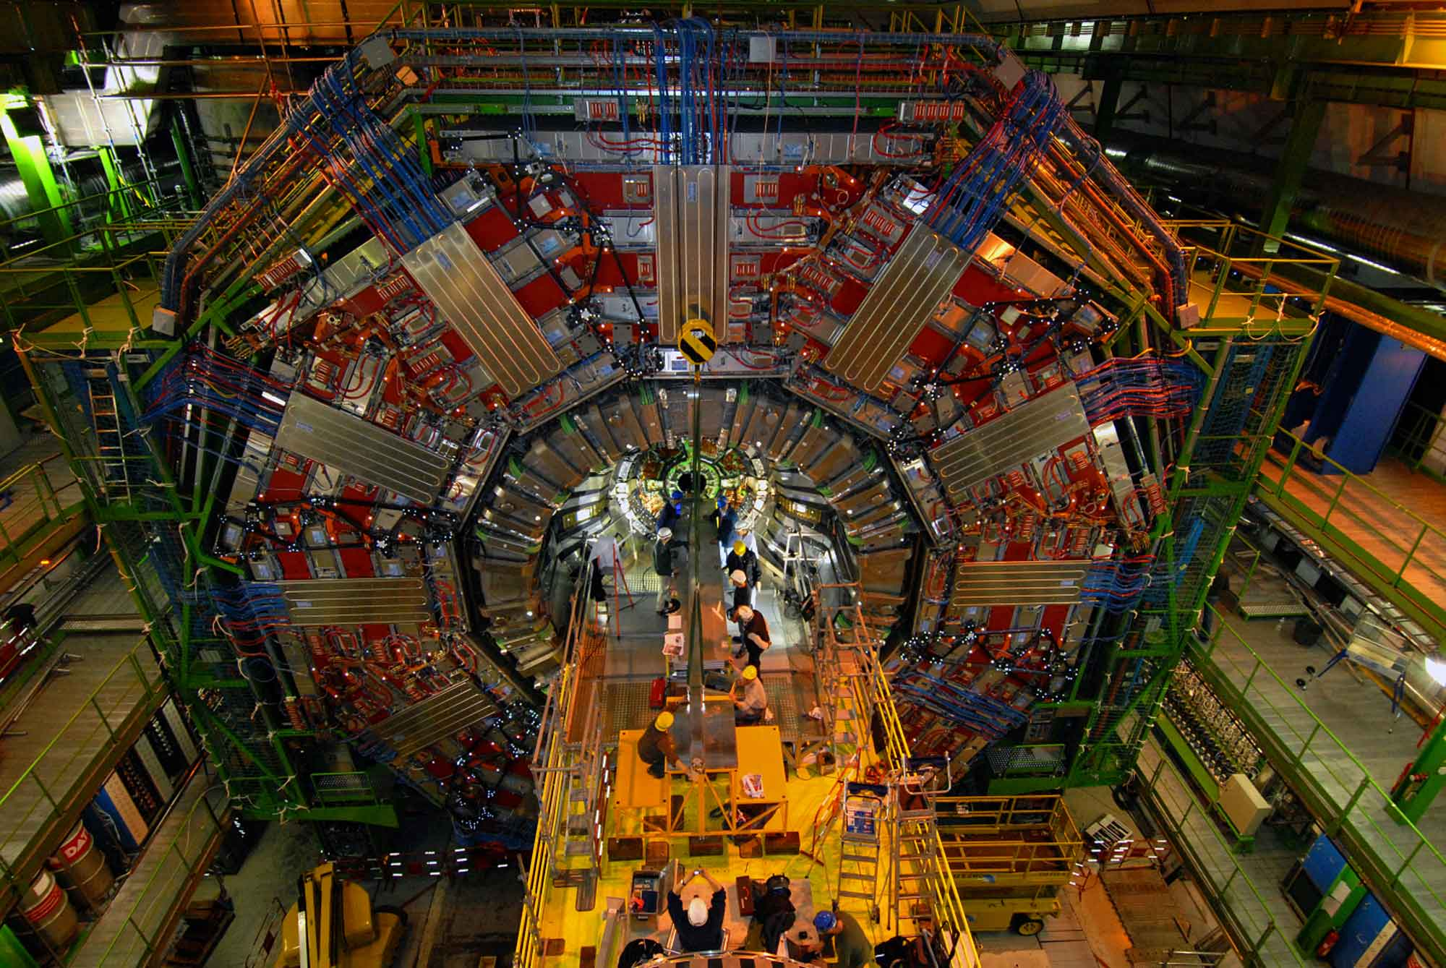
Putting It All Together - CMS Yardstick
Improvement Factors (total) with respect to G4
Legacy (TGeo) Geometry library:
1.5 → Algorithmic improvements in infrastructure.
2015 VecGeom (estimate)
2.4 → Algorithmic improvements in Geometry
Upcoming VecGeom (early result)
3.3 → Further Geometric algorithmic improvements and some vectorization
Some of the improvements can be back ported to G4
Overhead of basket handling is under control
Ready to take advantage of vectorization throughout.

Slide 29
Next steps
Repeat the test with the introduction of
Vectorised EM physics
Vectorised transport in Mag Field
Develop simple classes for materials and particles to be able to run on coprocessors to enable physics on the GPU and Xeon Phi full CMS yardstick
… implementing a “preliminary performance yard-stick” combining all prototype features
SIMD gains in the full CMS experiment setup
Coprocessor broker in action: part of the full transport kernel running on Xeon®Phi® and GPGPU
Scalability and NUMA awareness for rebasketizing procedure
… achieving these just moves the target a bit further
… testing scaling up to large node count through MPI, e.g. on CORI
Input distribution and Output gathering.

Slide 30
Engagement
VecGeom alpha release ready to be tested as Geant4 geometry update.
Magnetic field code update will also eventually be available to Geant4
VecCore can be used to develop technology agnostic vector code
GeantV ready to get out of the laboratory
Starting to think about/design interfaces for user actions, digitization, etc.
Welcoming early stakeholders to start reviewing the interfaces needed for a full application and develop more realistic tests and prototypes

Slide 31
Restating our case
We developed the three main components
A multithread scheduler to handle the particle baskets
A vectorised geometry library and navigator
A vectorised Compton scattering and a tabulated physics list
Our results indicate that
Basket handling introduces a minimal overhead
SIMD gains half an order of magnitude in performance
An optimistic prediction based on our results gives an improvement factor beyond the 3.3 currently achieved on CPU
GPU and Xeon Phi improvement factors are expected to be higher
We are on track with achieving our objectives (see slide 22, 2 to 5 speedup)

Slide 32
Thank you!

Slide 33
BACKUPS

Slide 34
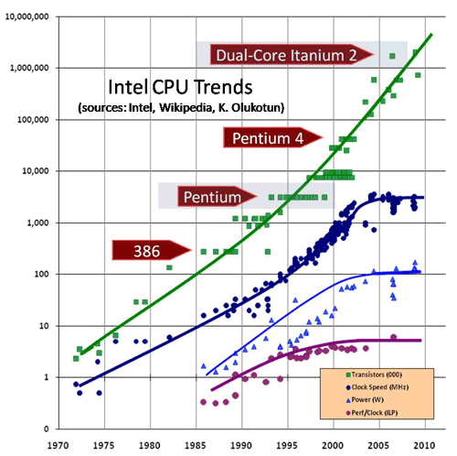
GeantV: (familiar) motivations
Performance of our code scales with clock cycle (hence is stagnant!)
Needs will increase more than tenfold and the budget will be constant at best
HEP code needs to exploit new architectures and to team with other disciplines to share the optimization effort
Data & instruction locality and vectorisation
Portability, better physics and optimization will be the targets
Simulation can lead the way to show how to exploit today's CPU's resources more effectively in complex applications
10⁷
10⁶
10⁵
transistors
clock
10⁴
10³
10²
10
1
power
ILP
10⁻¹
70
75
80
85
90
95
00
05
10
Seeking ways to write code portable between CPU with vector units or not and accelerators (GPU, Xeon Phi)

Slide 35
Why not Geant4+?
Extensive prototyping and analysis has convinced us that “vectorisation” of Geant4 was not achievable without a major rewrite of the code
No hotspots (!)
Virtual table structure very deep and complex (1990’s style)
Codebase very large and non-homogeneous
Auto-vectorization can only have small and very localized effect
No criticism, but even the best things age (born 1994)

Slide 36
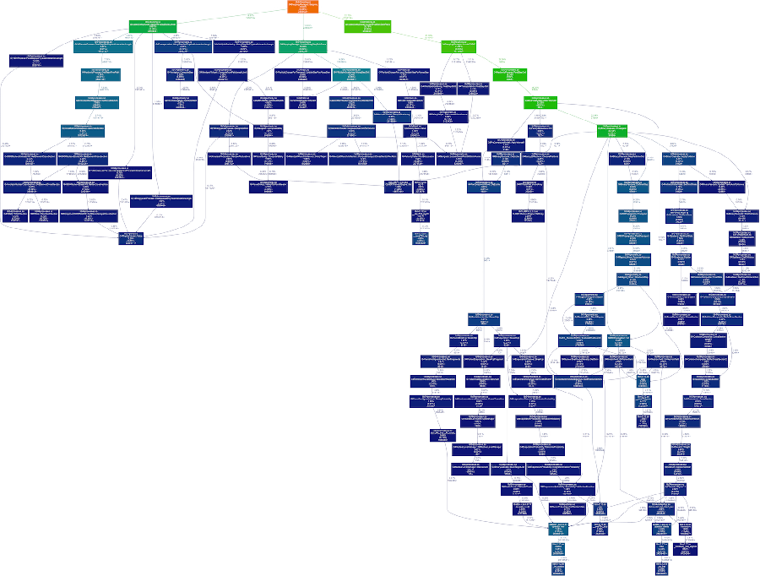
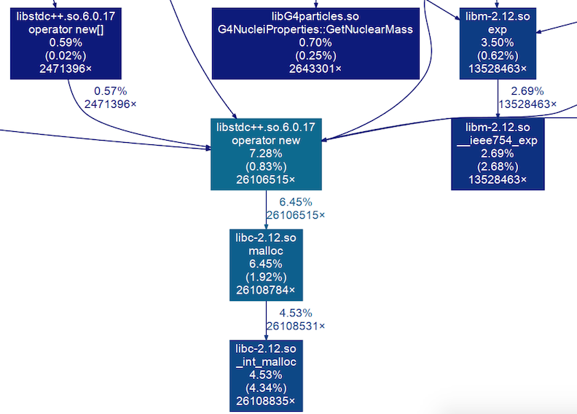
Geant4 Profiling Example: Call Graph
Geant4 example B1 with 100 protons
valgrind / gprof2dot / graphviz
Small and Smaller boxes!!

Slide 37
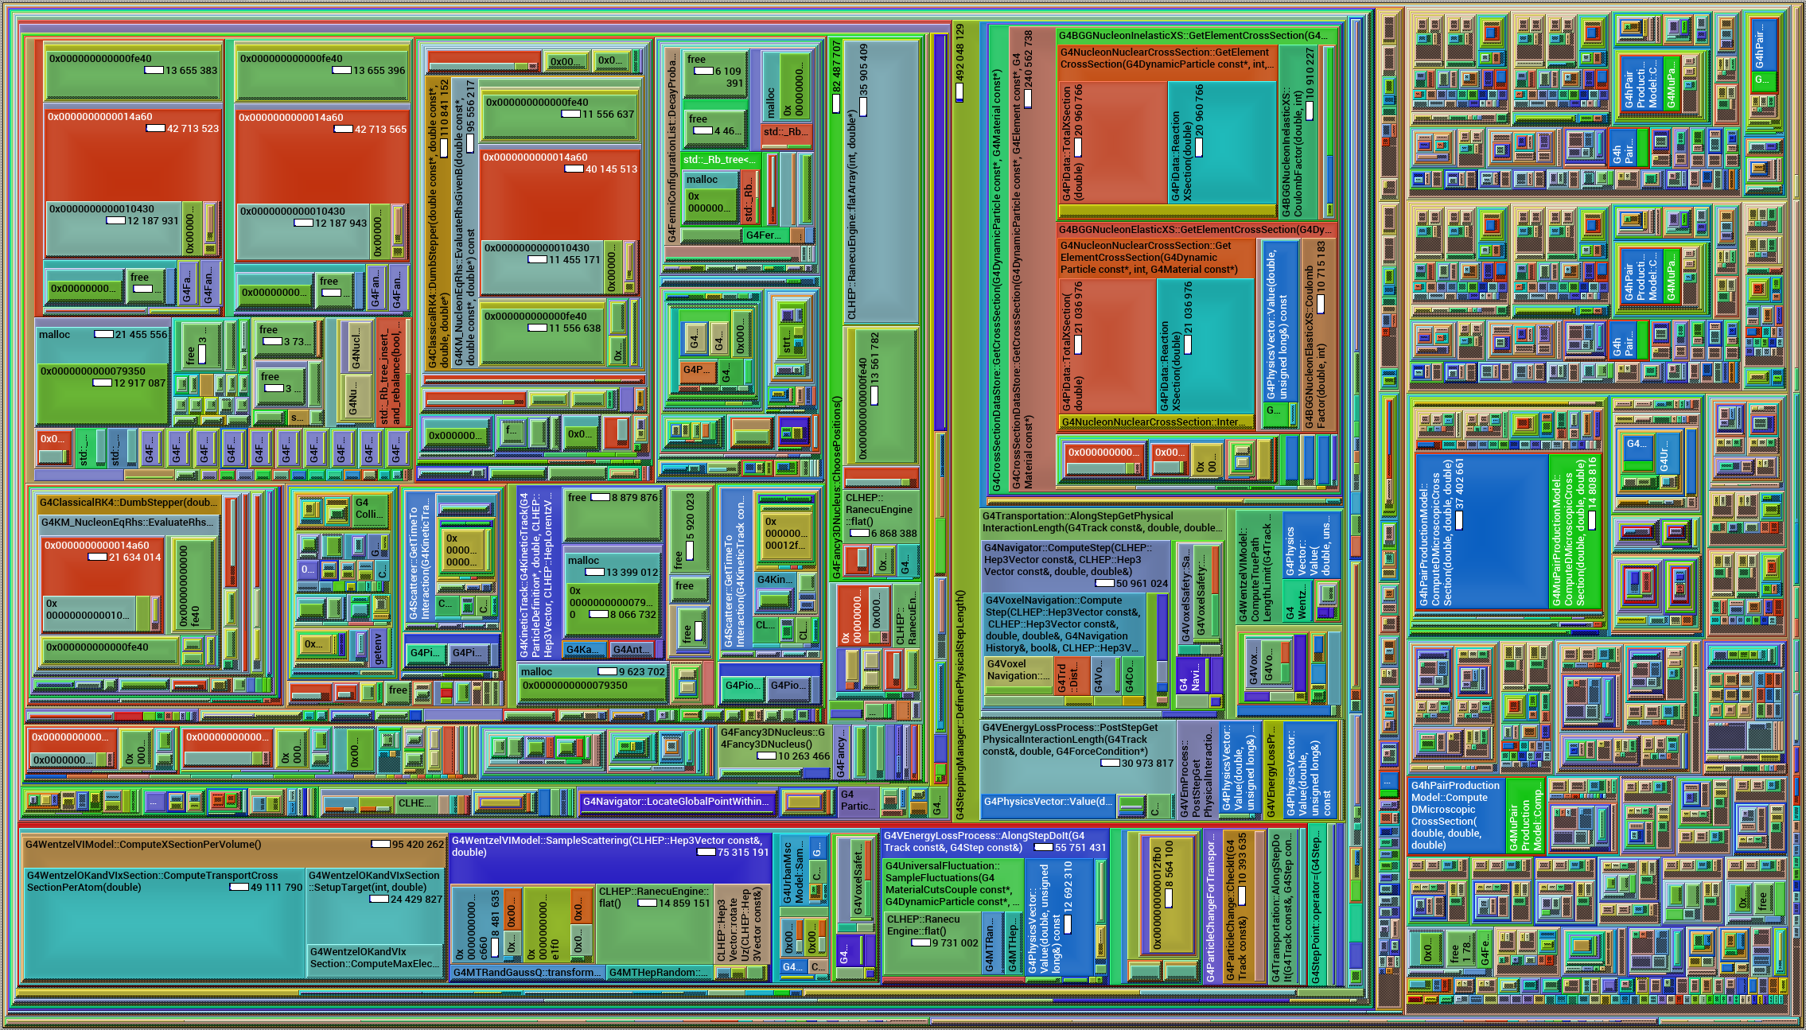
Geant4 Profiling Example: Call Map
valgrind / kcachegrind
No easy to address hotspots

Slide 38
“Basketised” transport
Deal with particles in parallel
A dispatcher thread puts particles back into transport buffers
Everything happens asynchronously and in parallel
Output buffer(s)
The challenge is to minimise locks
Keep long vectors
Avoid memory explosion
Particles are transported per thread and put in output buffers

Slide 39
Explicit vectorization
Explicit SIMD vectorization can be implemented directly using intrinsics, but a vectorization library already brings many utilities pre-defined, like common math operators and functions.
VecGeom currently works with Vc library, by Mathias Kretz, but other libraries can be easily plugged in (Agner Fog's VCL, Intel's VML, Cilk Plus, …). A new backend is maybe all that is needed.
Notes:
3/31/16
39
39

Slide 40
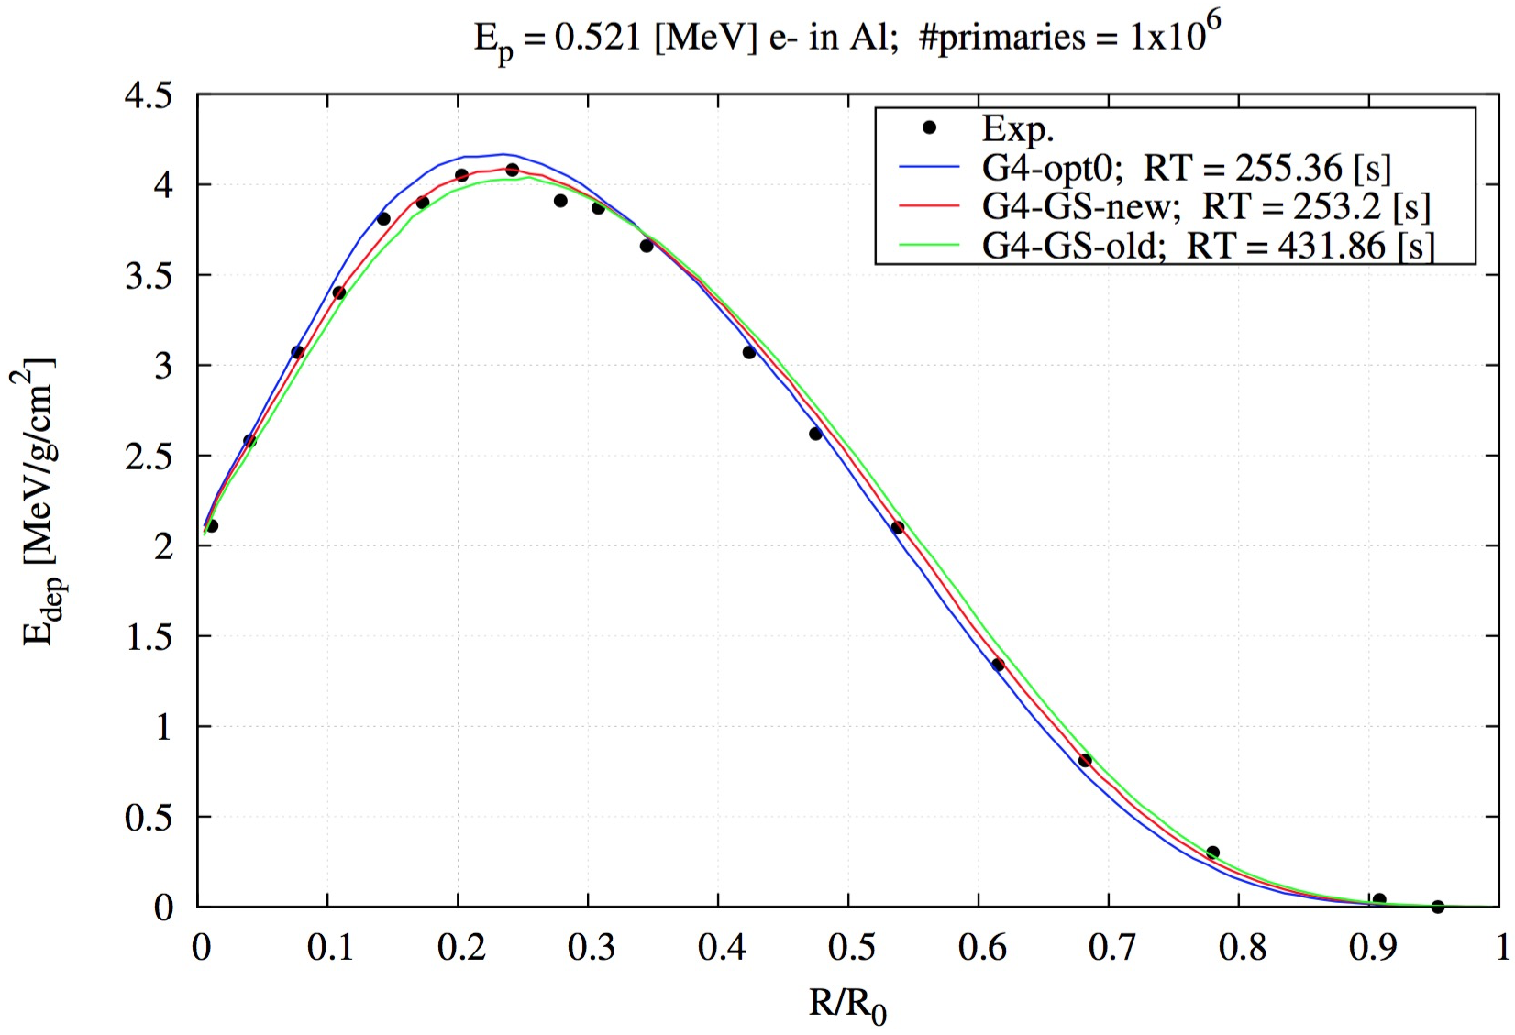
Physics developments: Multiple Scattering
G4 fast
GV
G4 precision
Sandia data
Source: M.Novak

Slide 41
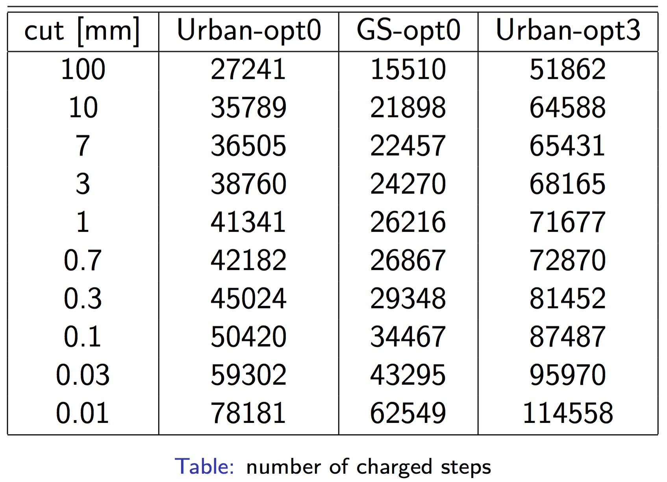
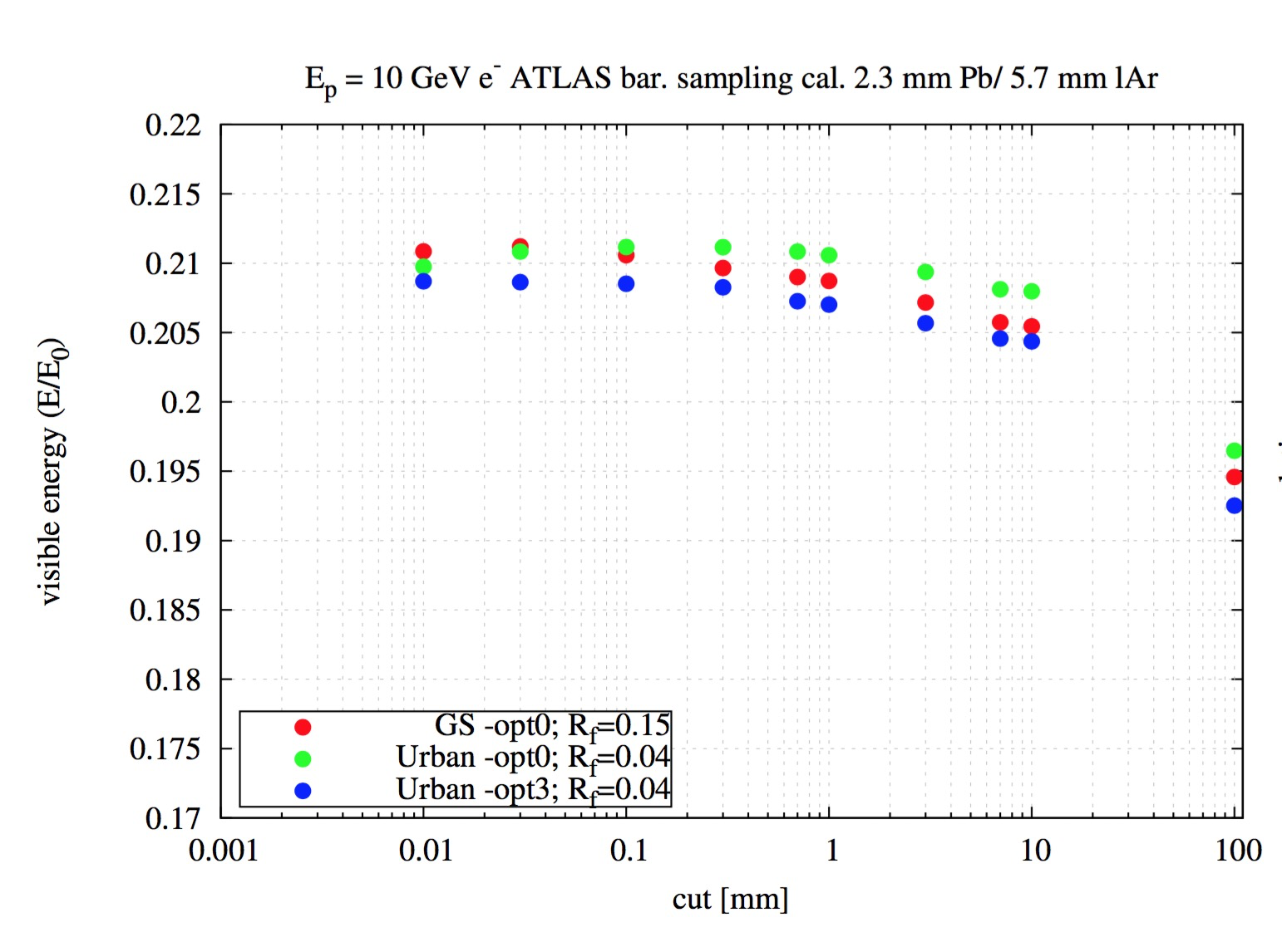
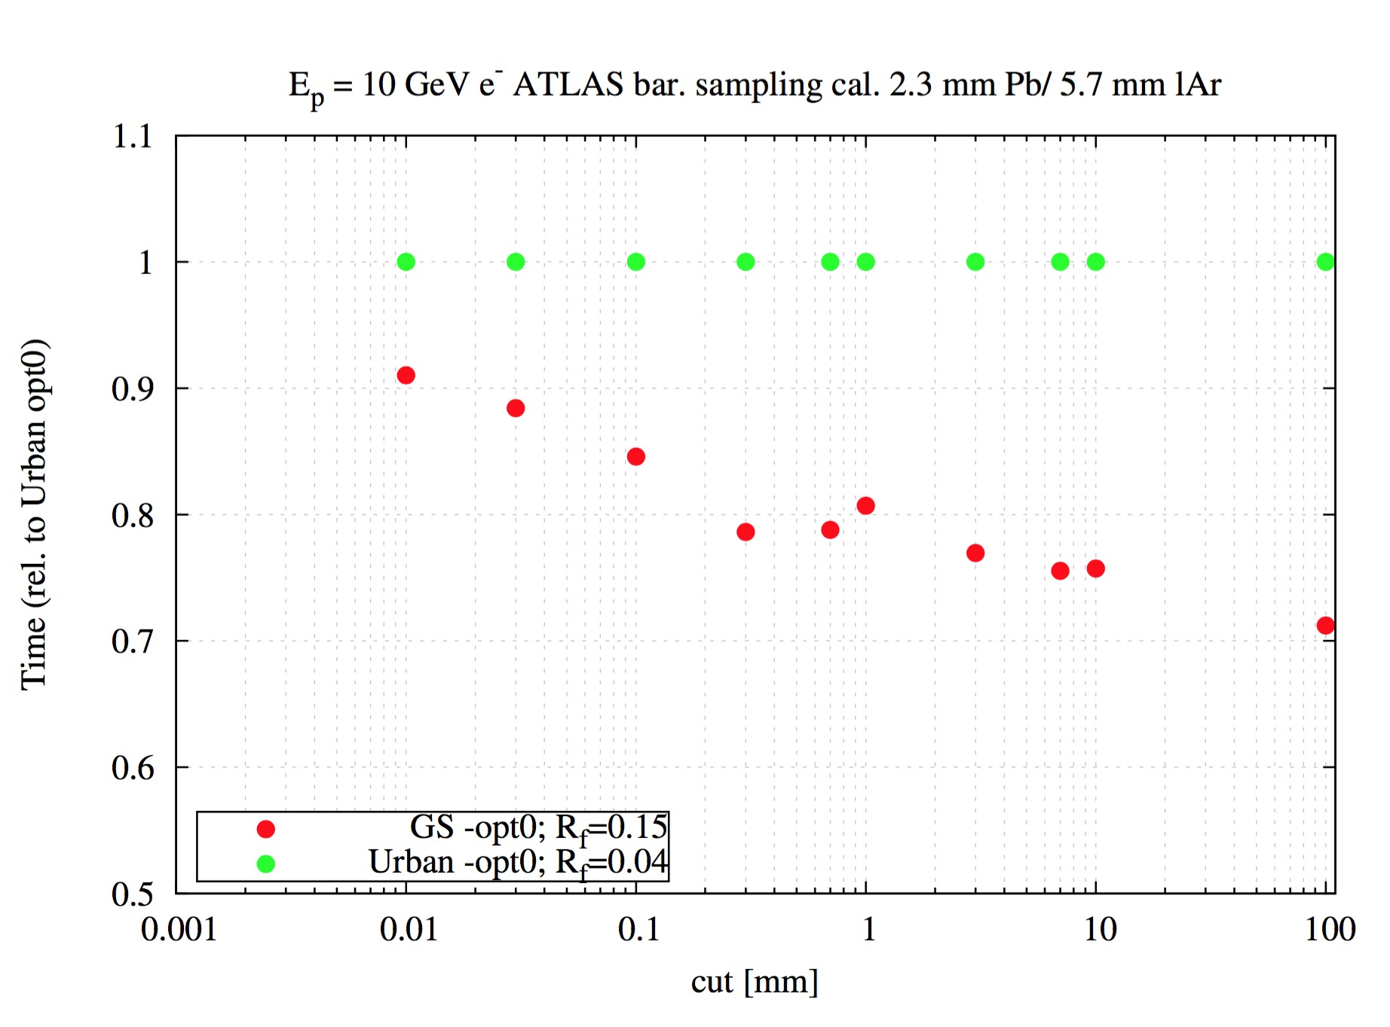
GeantV Multiple Scateeting
Less charged steps (30%-50%)
Physics validation
The new algorithm is being now vectorised for GeantV
It is in an experimental physics list for Geant4
Candidate to become the default
Up to 30% faster in scalar

Slide 42
The problem
Detailed simulation of subatomic particle transport and interactions in detector geometries
Using state of the art physics models, propagation in electromagnetic fields in geometries having complexities of millions of parts
Heavy computation requirements, massively CPU-bound, seeking organically HPC solutions…
The LHC uses more than 50% of its distributed GRID power for detector simulations (~250.000 CPU years equivalent so far)
http://atlas.ch

Slide 43
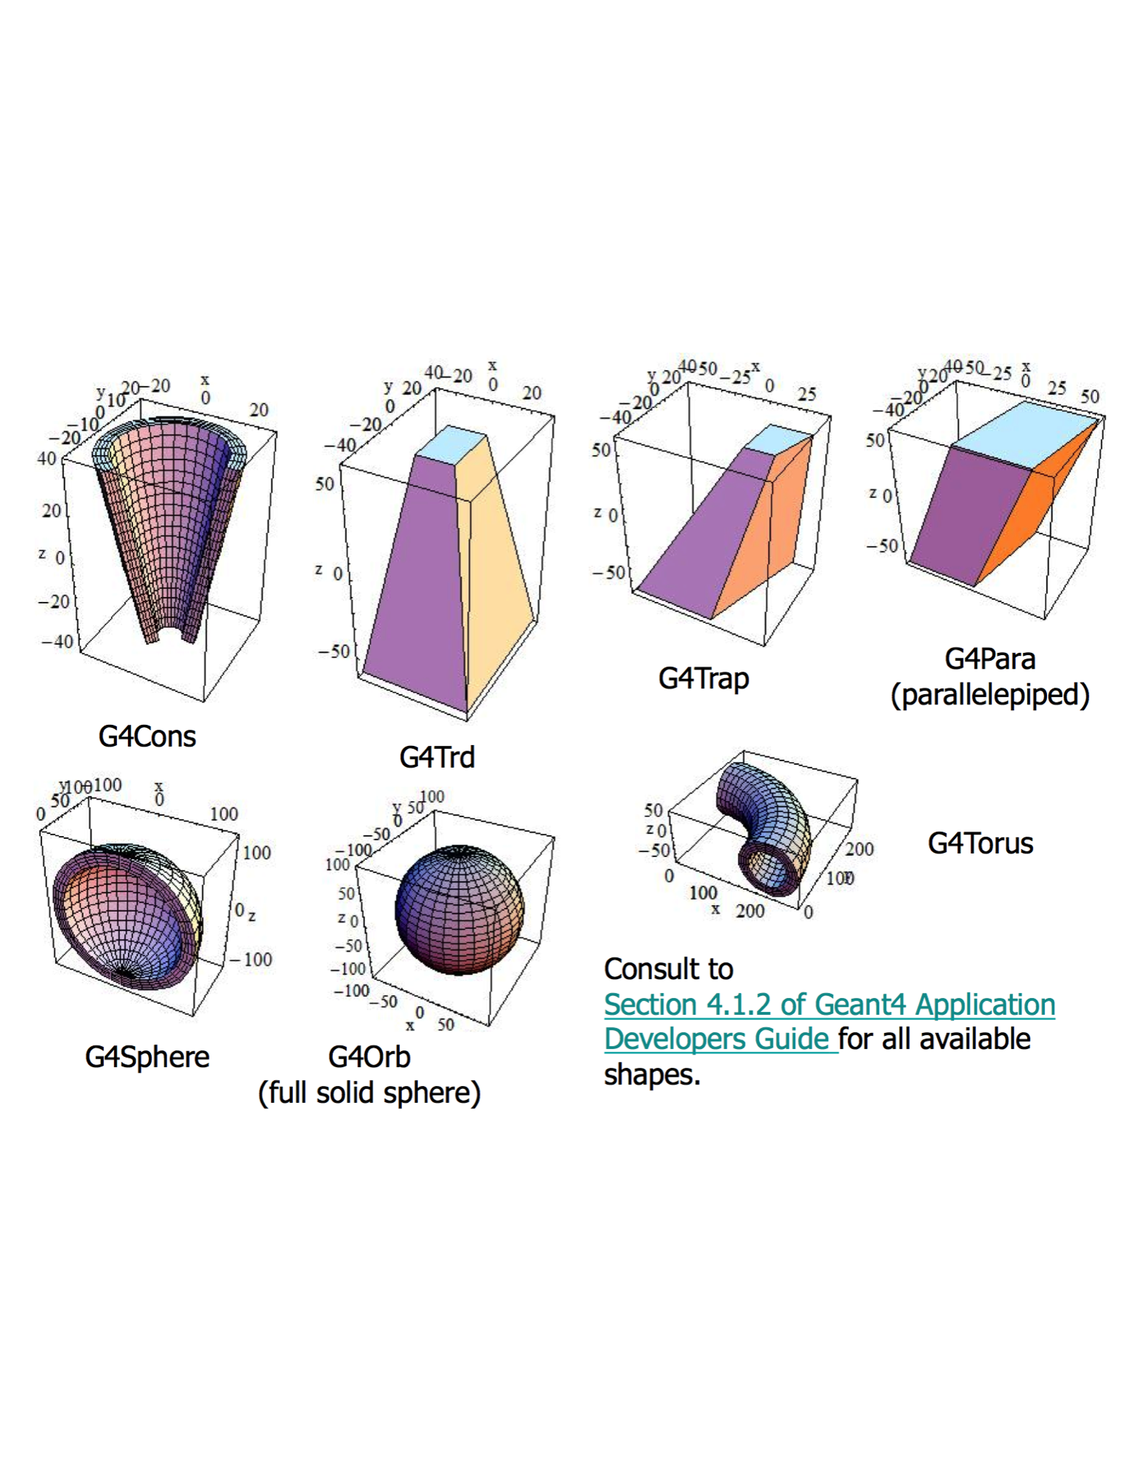
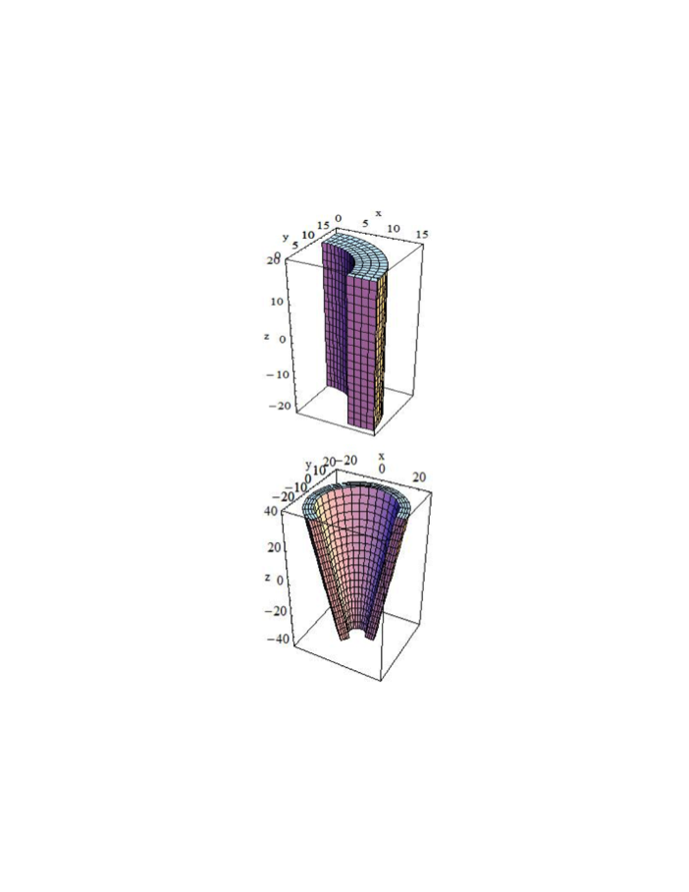
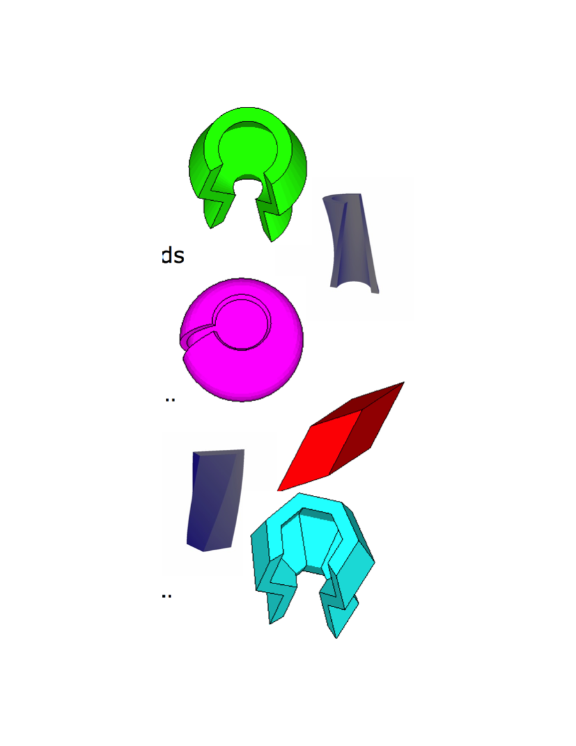
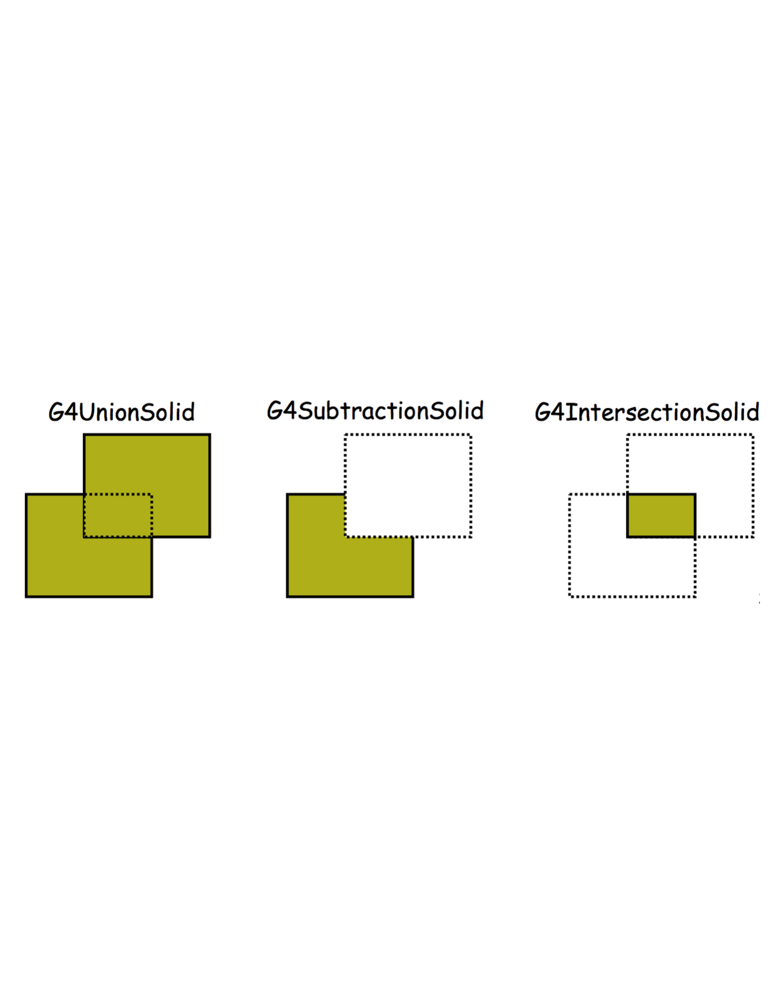
Geant4 Geometry
A large collection of solids are defined in Geant4:
G4Tubs
G4Cons
G4Polycone, G4 Polyhedra, G4Hype, G4TwistedTubs, G4TwistedTrap
Also Boolean operations such as:

Slide 44
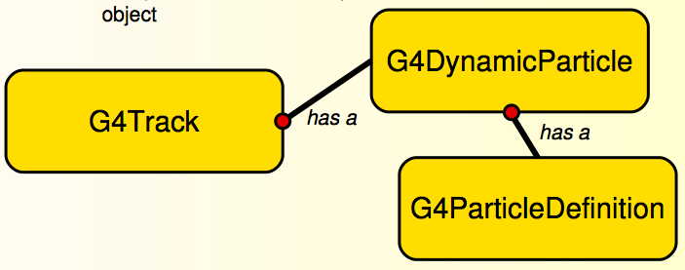
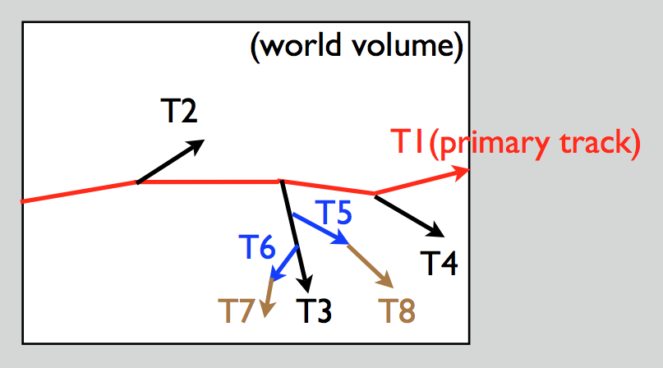
Geant4 Transportation
A G4Track also includes the info for transporting the particle through the detector ➔ in G4 we typically use Particle = Track
Tracking follows “last in first out” rule:
T1->T4->T3->T6->T7 ->T5->T8->T2
T2-T8 (secondary tracks)
The G4Track information is updated after every G4Step
A G4Step is a step in the particle (track) propagation
The user defines a maximum step length but steps also end when a physics process is invoked and at volume boundaries

Slide 45
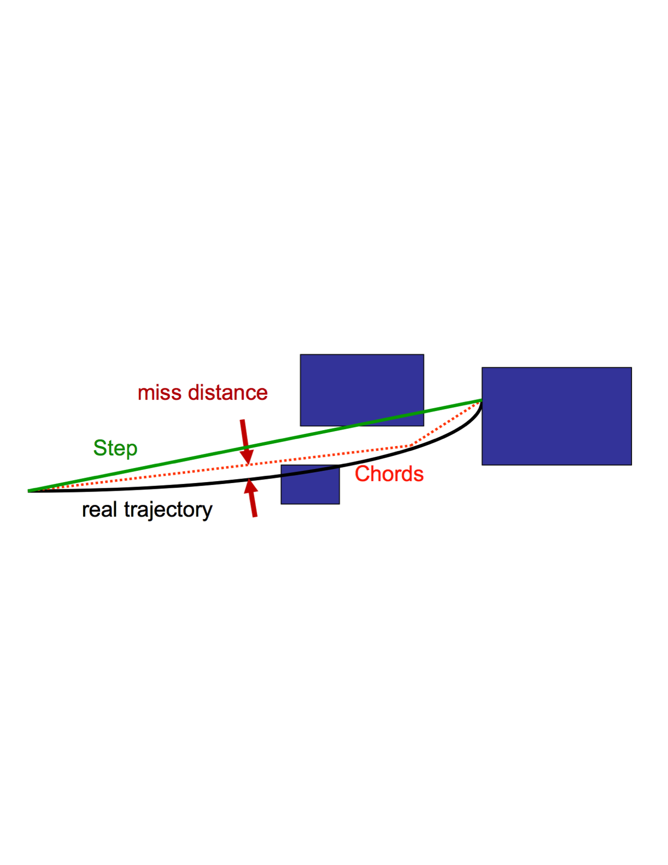
Geant4 Magnetic Field
Particle propagated in EM field by integration of equation of motion using the Runge-Kutta method (others also available)
Curved path broken into linear chord segments to minimize the sagitta (maximum chord-trajectory distance)
Chords used to interrogate navigator on whether the track has crossed a volume boundary
miss distance parameter used to tune volume intersection accuracy
G4 supports user defined, uniform, and non-uniform (static or time dependent) magnetic fields

Slide 46
Specialized Geometry Library.
Backward compatibility with ROOT and Geant4
Continue the already started AIDA USolids project
Numerical simulation have special requirements on numerical stability (double vs float, no leaks, we transport things across boundaries often not the case in 3D graphics engines)
HEP use specialized volumes not existing in external packages (polycone) and we can put a lot of domain specific knowledge to accelerate things
Single solution for CPU and GPU
Rely on special functions "safety" which might not exist in classical 3D rendering engines (which concentrate on hit detection)
Need an exact volume representation (and not a triangle approximation).
Different scale than most 3D graphics engines (that often have far fewer things to treat)

